Slide 1



Adenocarcinoma de Endometrio, Qué Tenemos que Saber
XXV CONGRESO CHILENO DE ANATOMÍA PATOLÓGICA
14 de Octubre, 2022
Anaís Malpica, M.D.
Profesora
Departmento de Patología

Slide 2
Objectives
How to deal with challenges in the diagnosis
of endometrial cancer ?
Clinical context
Histological and immunohistochemical features
Dx criteria
Awareness of pitfalls

Slide 3
Serous Ca
Clear cell Ca
Undiff Ca
Endom Ca
NE Ca
Dx criteria are histotype-specific
Mucinous Ca
Mesonephric-like Ca

Slide 4
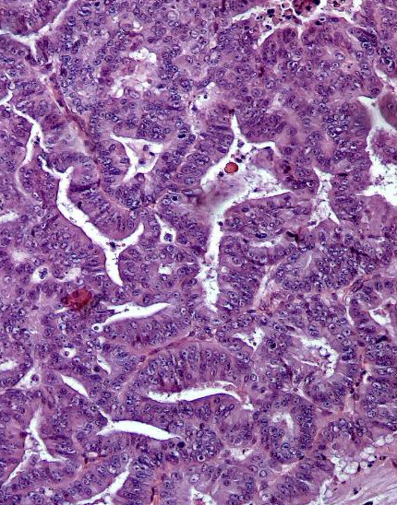
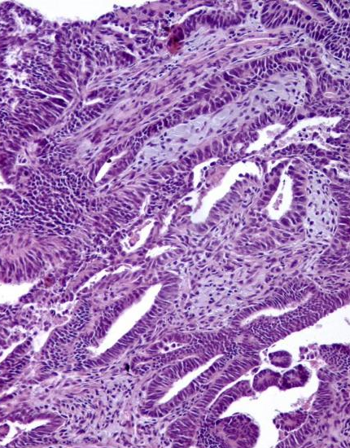
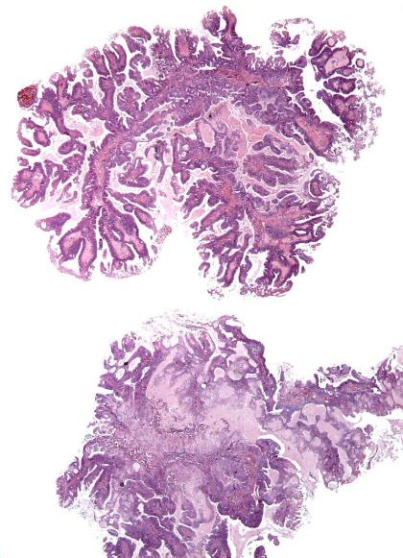
Endometrioid Adenocarcinoma, FIGO grade 1:
What You Need
Any of these 3 criteria
Confluent glandular pattern measuring
2 x 2 mm
Irregular glands infiltrating a desmoplastic tissue
An extensive papillary pattern

Slide 5
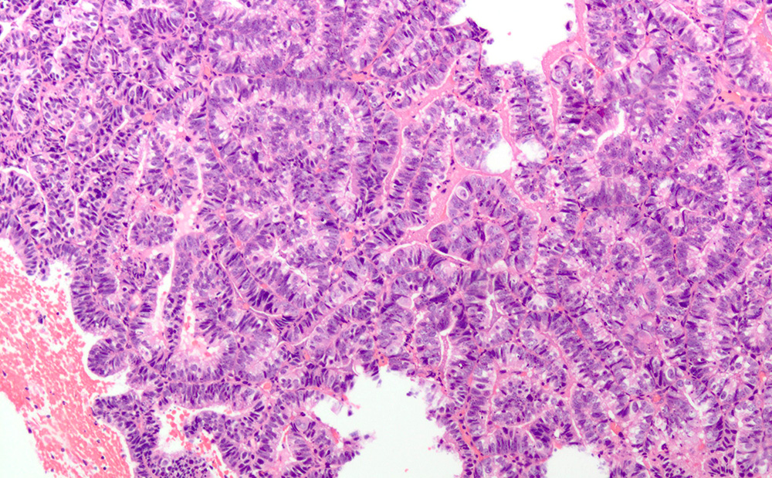
Caveat: Be attentive to the cytologic features
This serous carcinoma has a glandular pattern and mimics an endometrioid adenocarcinoma

Slide 6
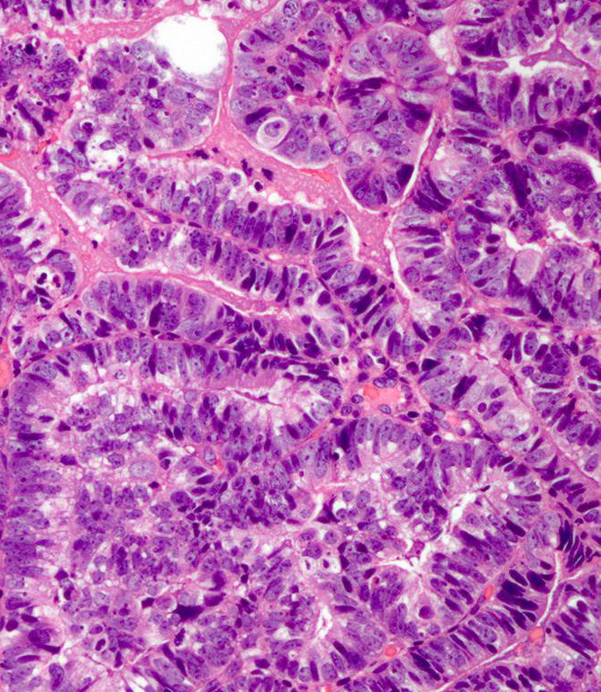
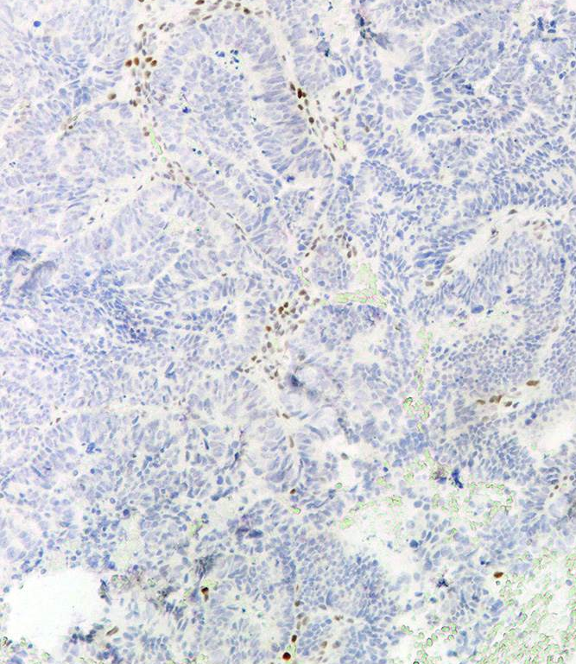
Serous carcinoma, not an endometrioid adenocarcinoma
Note the high nuclear:cytoplasmic ratio, the irregular distribution of the chromatin, and numerous apoptotic bodies
Aberrant p53 expression, “null case”

Slide 7
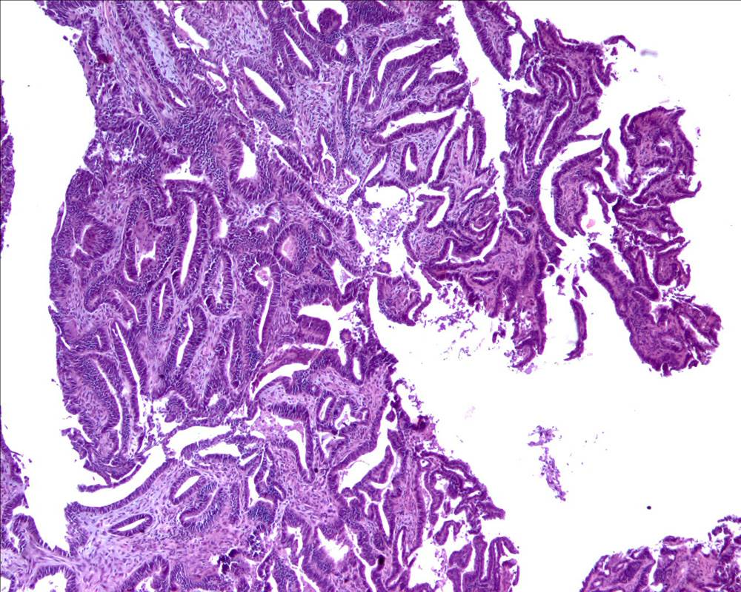
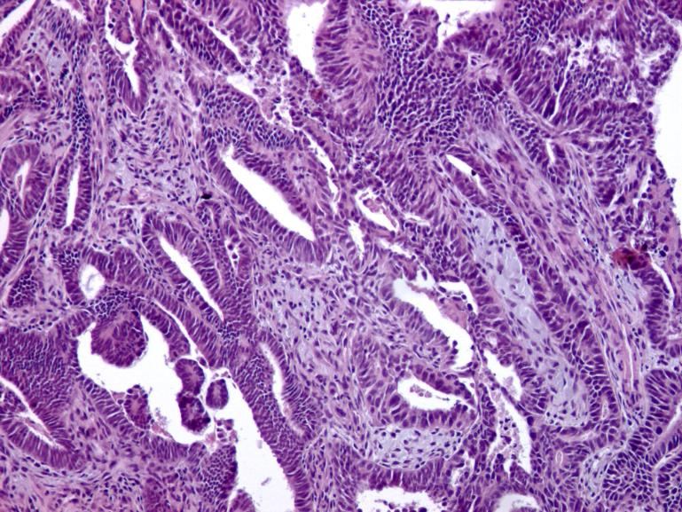
Desmoplastic Reaction
Ensure that this change is not reactive due to a recent curettage

Slide 8
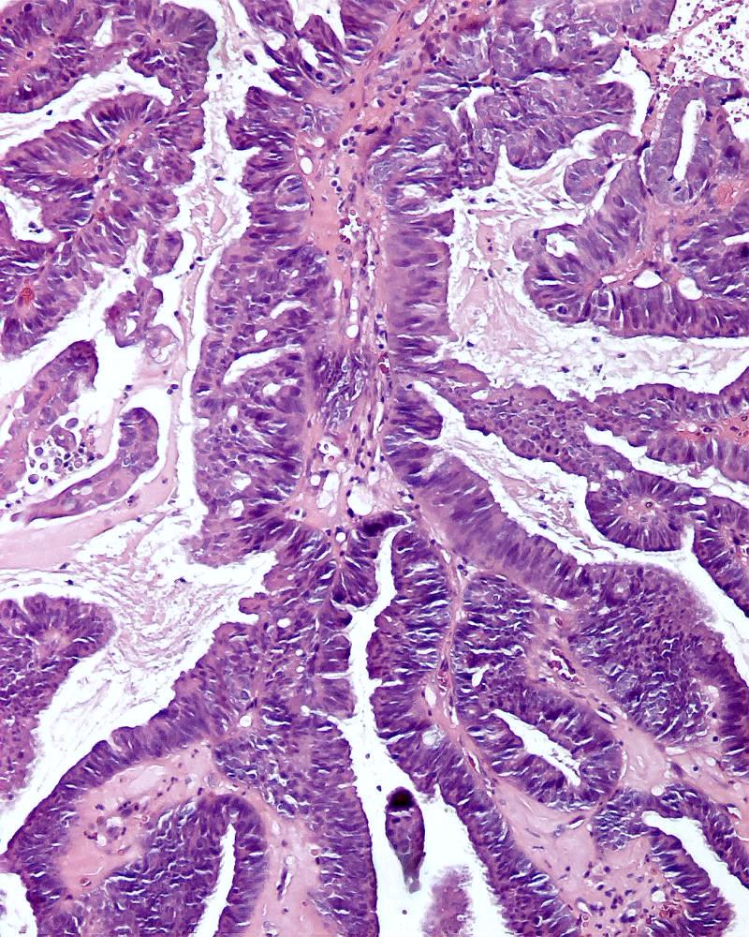
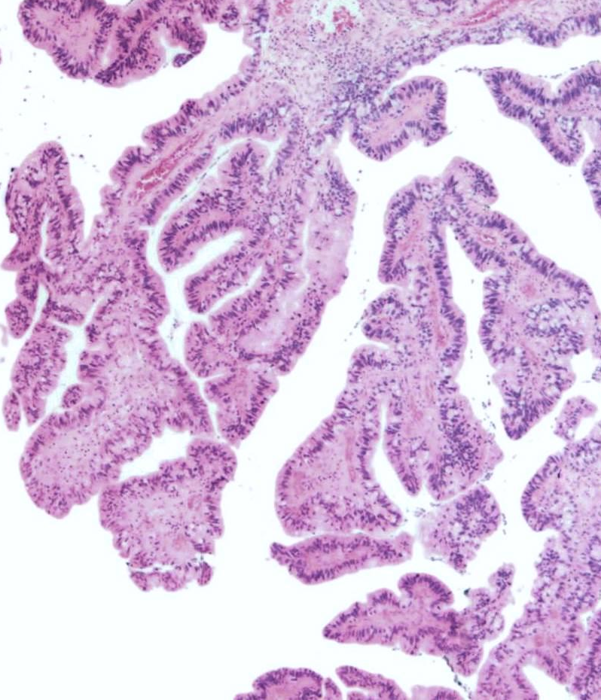
Endometrioid Adenocarcinoma, Extensive Papillary Pattern - When dealing with this pattern an endocervical origin has to be ruled out
Cervical Adenocarcinoma in an Endometrial Biopsy, Extensive Papillary Pattern

Slide 9
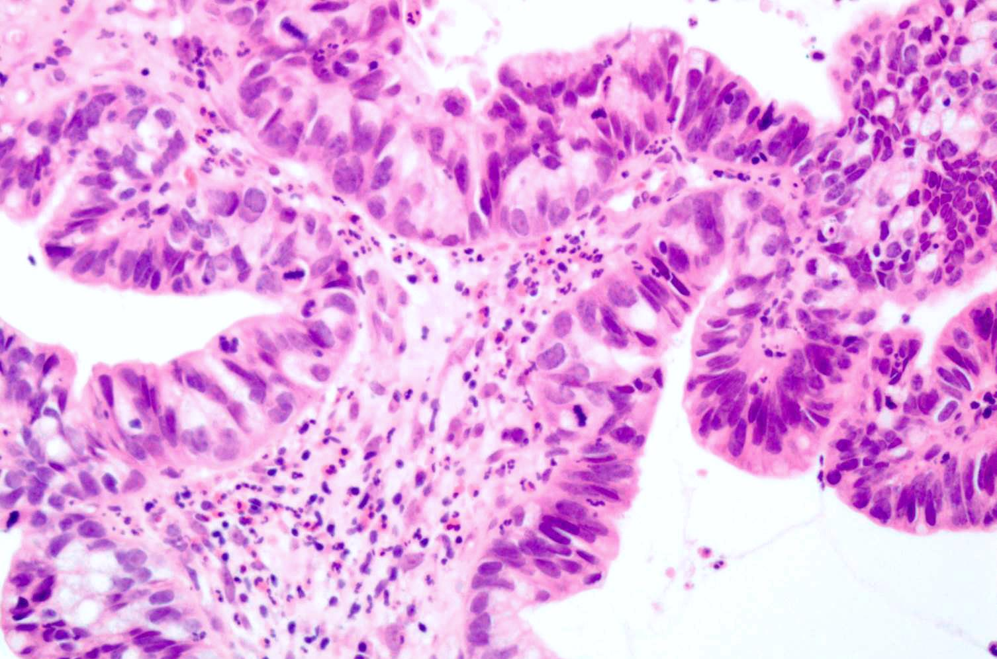
Higher magnification of cervical adenocarcinoma, note the presence of numerous apoptotic bodies and apical mitoses

Slide 10
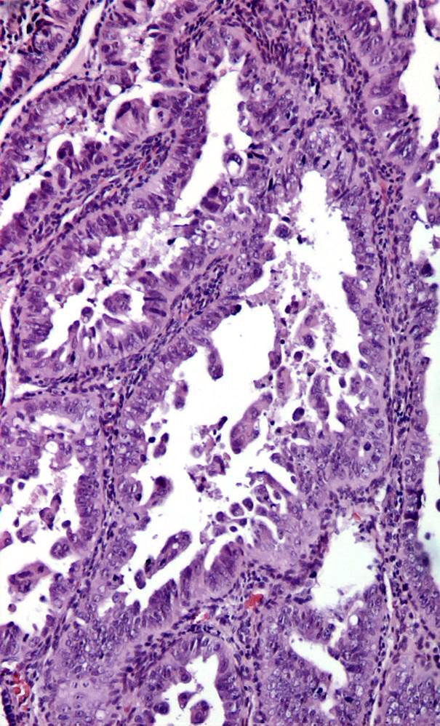
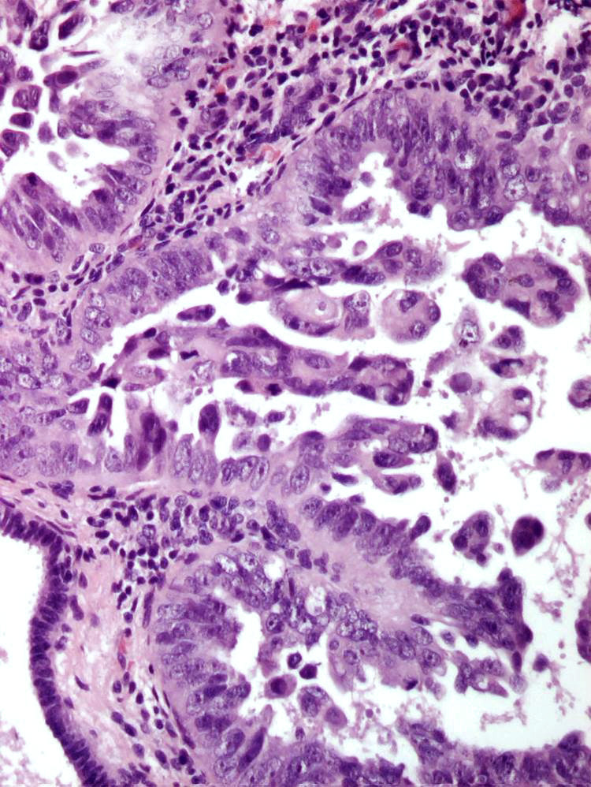
Serous carcinoma, papillary structures,
marked atypia and numerous mitoses

Slide 11
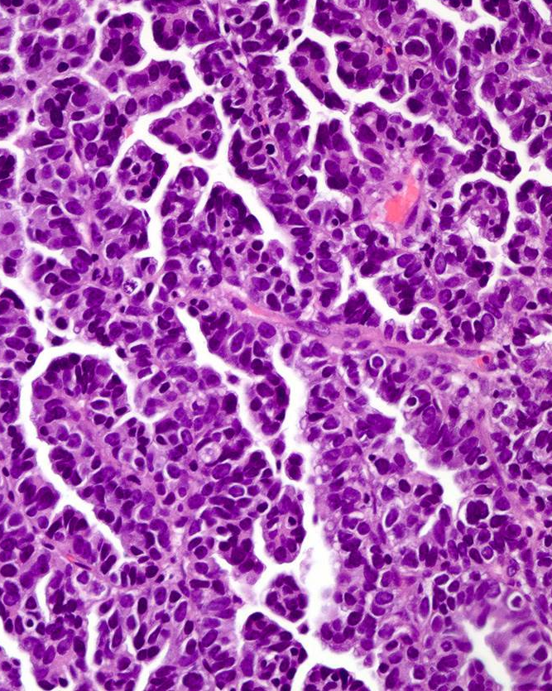
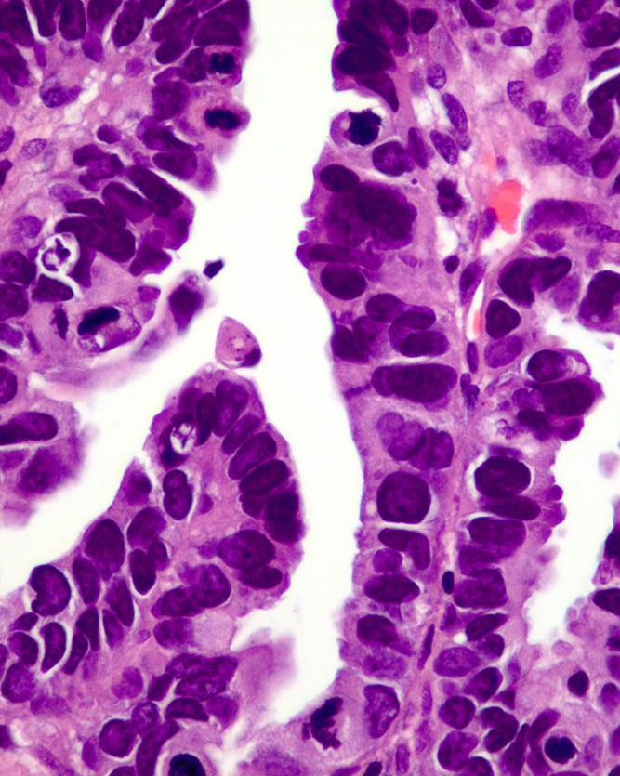
Serous Carcinoma
At first glance, the degree of pleomorphism appears not to be marked
Higher magnification, marked cytologic atypia and numerous mitoses

Slide 12
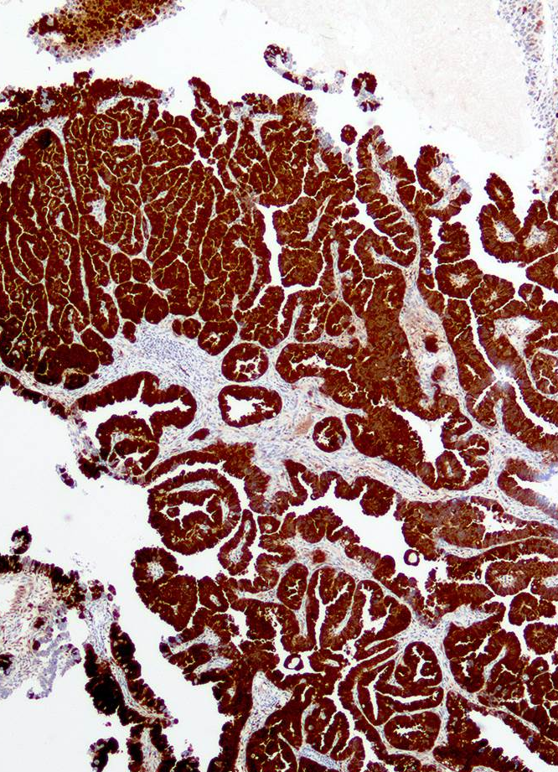
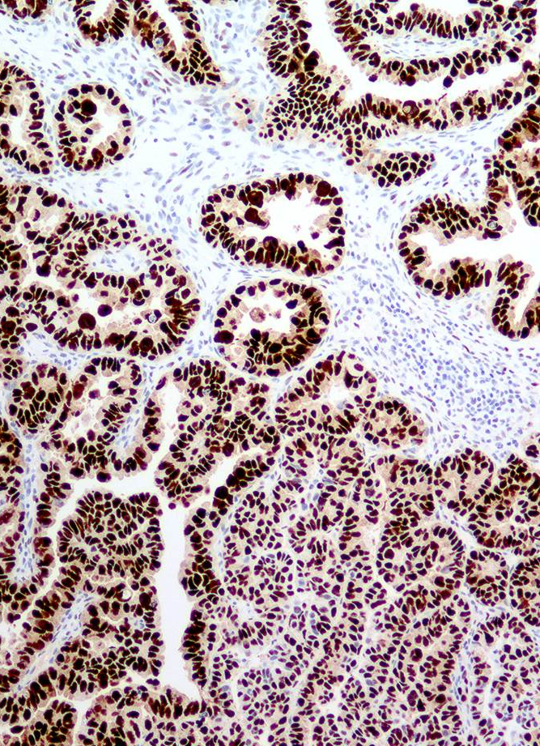
p16, strongly and diffusely positive
p53, positive in ≥ 75% of the cells

Slide 13
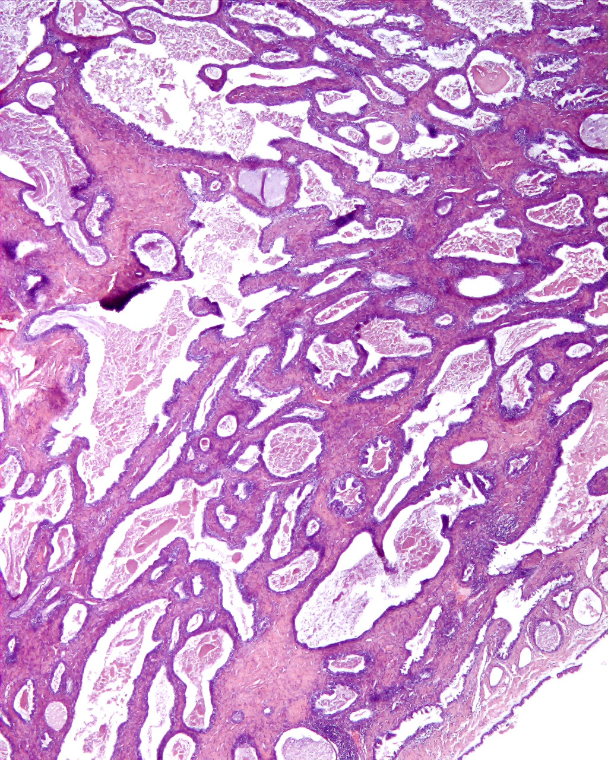
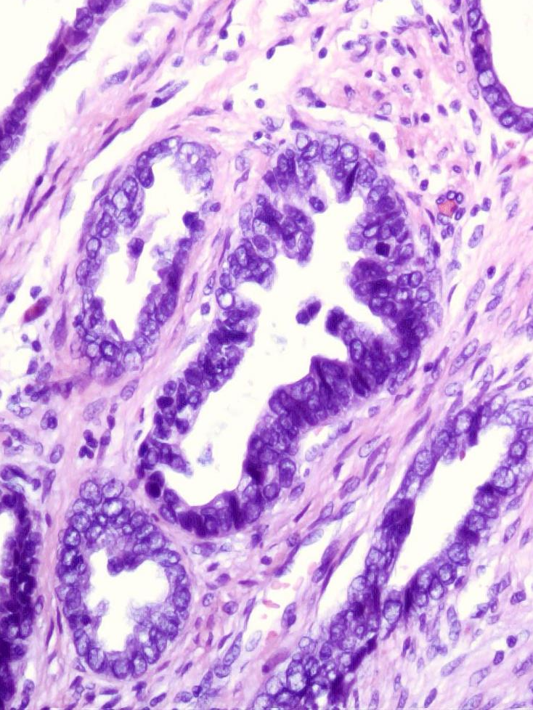
At low magnification, hyperplastic changes
are noted. Be aware of glands that appear
darker.
Serous carcinoma confined to the glandular epithelium. Marked nuclear atypia and conspicuous mitotic activity.

Slide 14
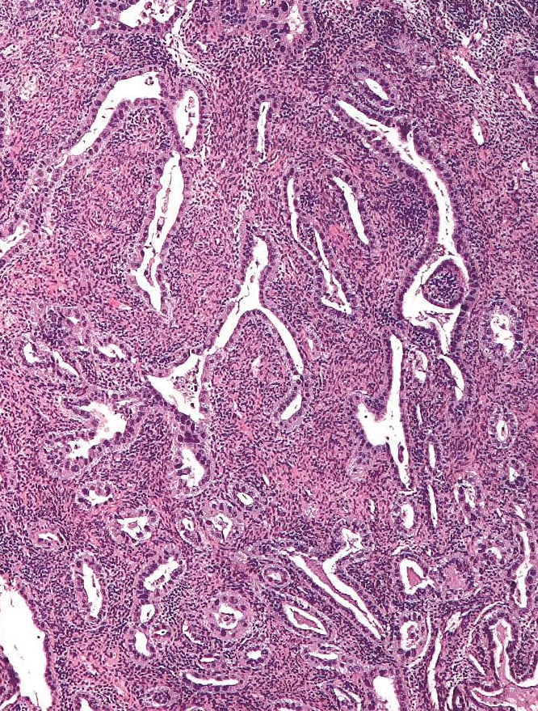
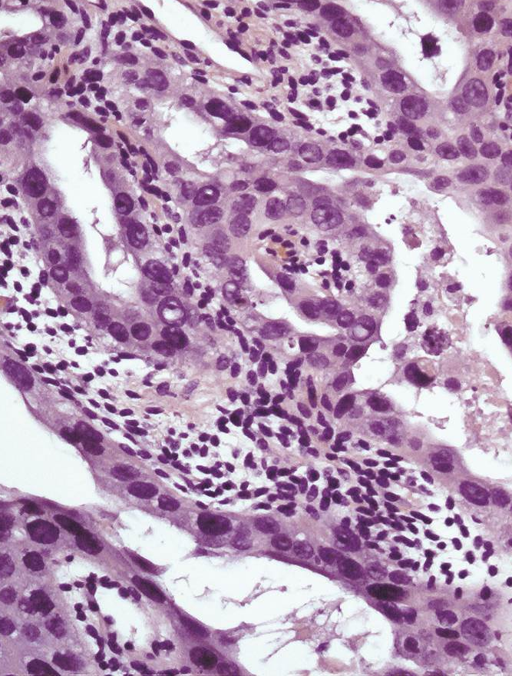
Serous carcinoma mimicking complex atypical hyperplasia
Note the marked nuclear pleomorphism

Slide 15
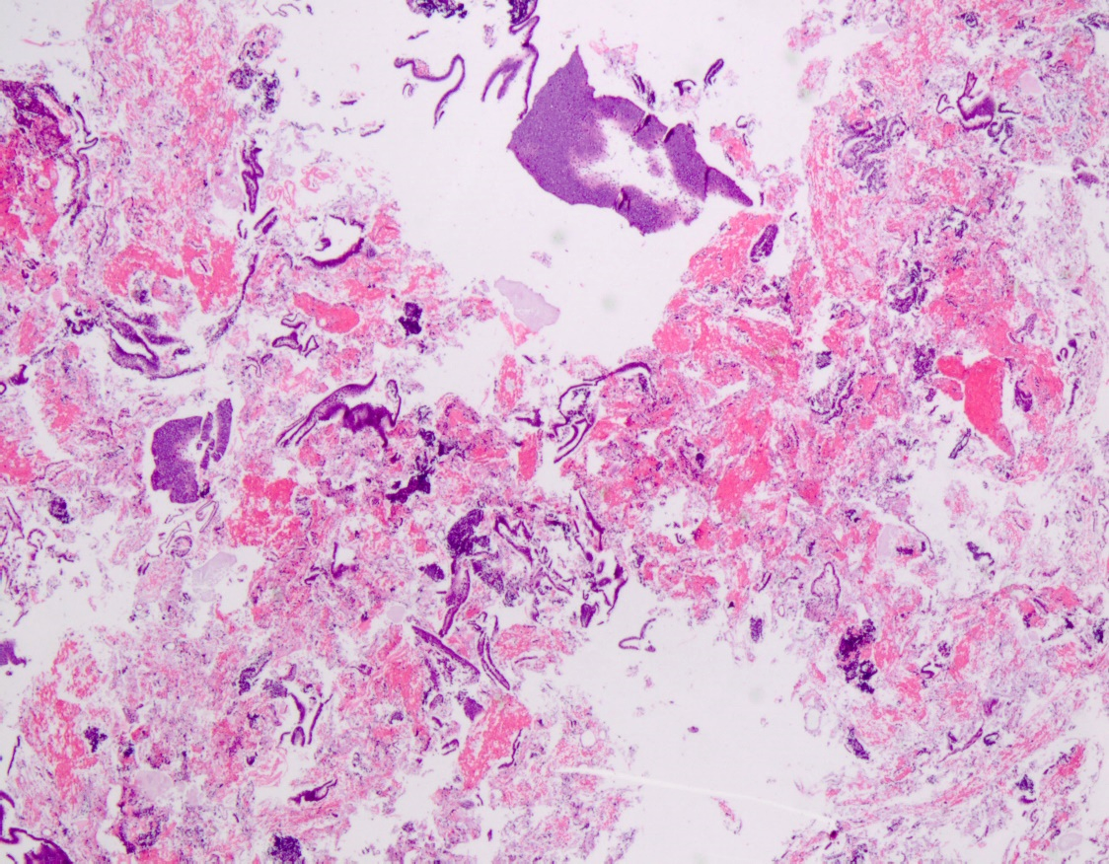
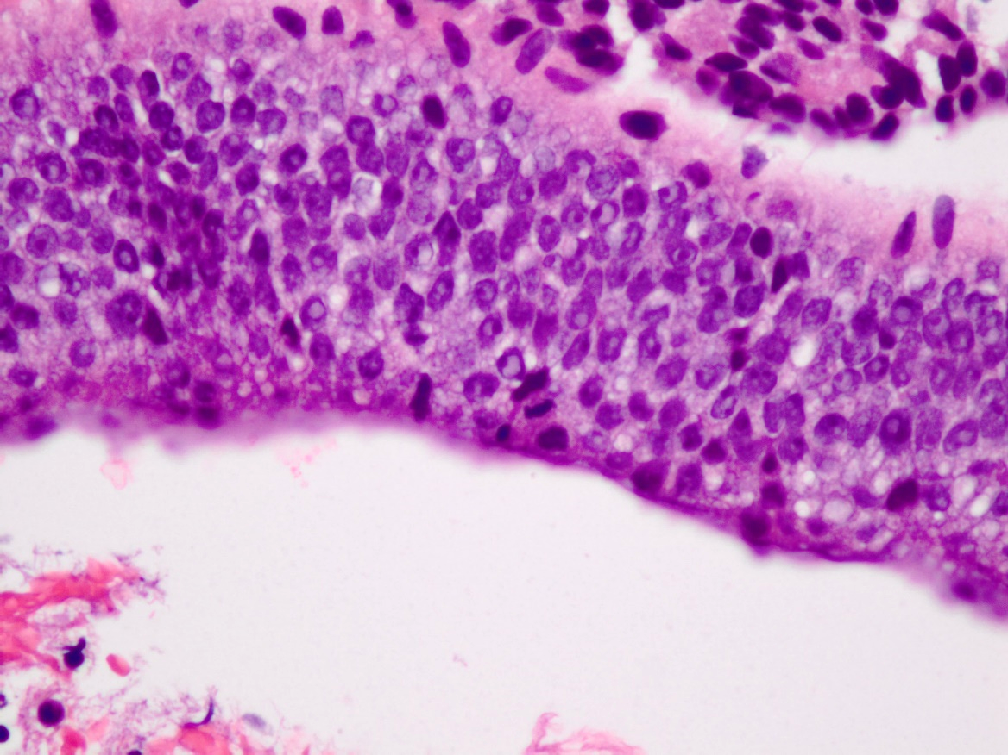
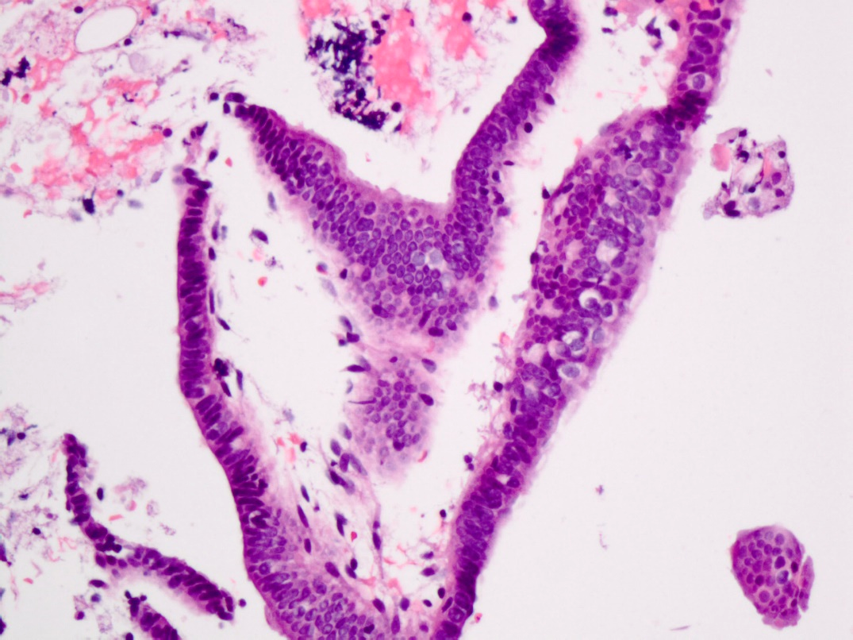
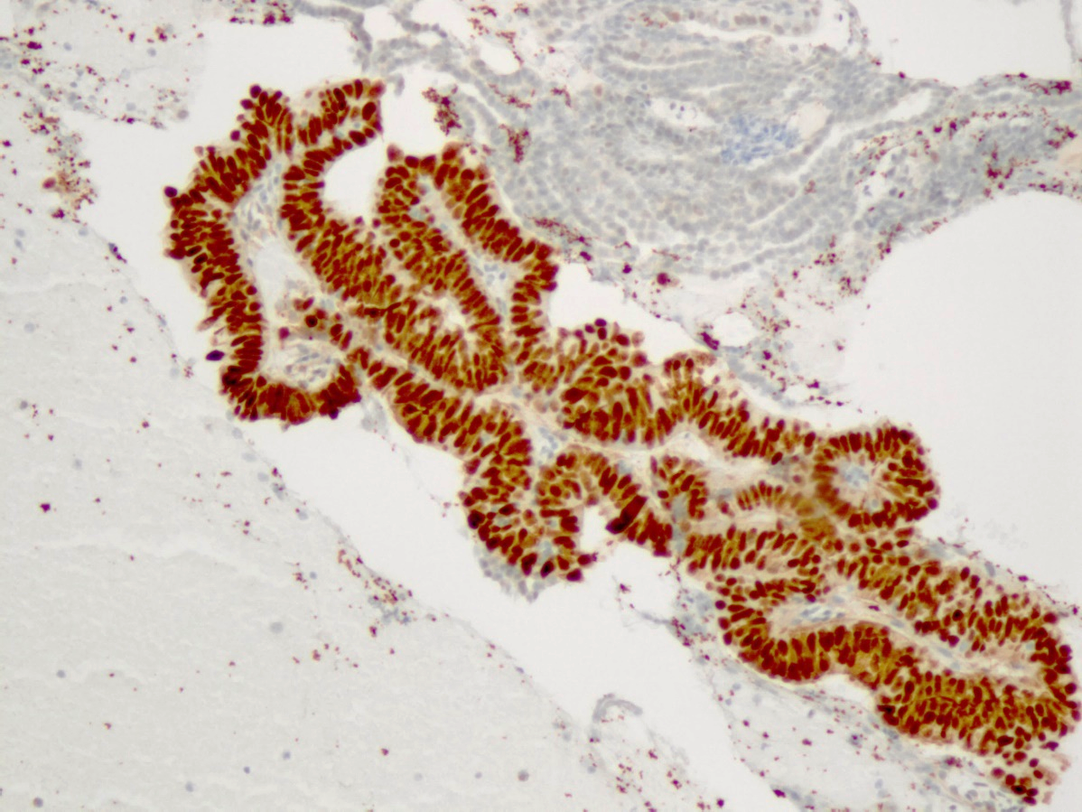
Small fragments of tissue, atrophic endometrium and serous Ca
p53

Slide 16
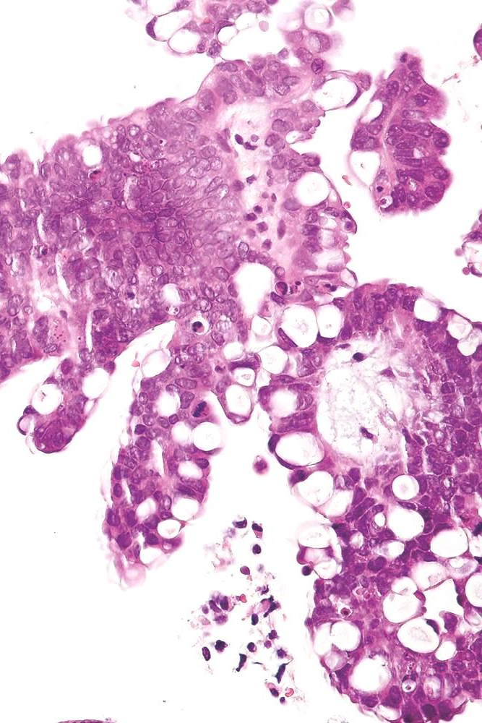
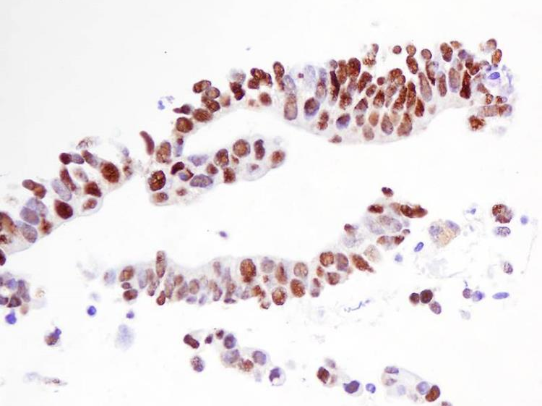
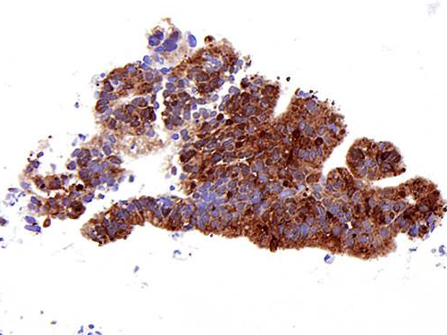
p53, difficult to interpret
Serous Carcinoma, the presence of vacuoles represents a confounding factor
p16, diffusely positive

Slide 17
Serous Carcinoma
IHC:
  Aberrant expression of p53
    either + in ≥ 75% of the cells or absent
    Rare case with only cytoplasmic staining
  p16
    diffusely positive
  PTEN almost always retained
    PTEN mutation is seen in approximately 11% of cases
  ER positive, PR negative/positive
  PAX-8 positive

Slide 18
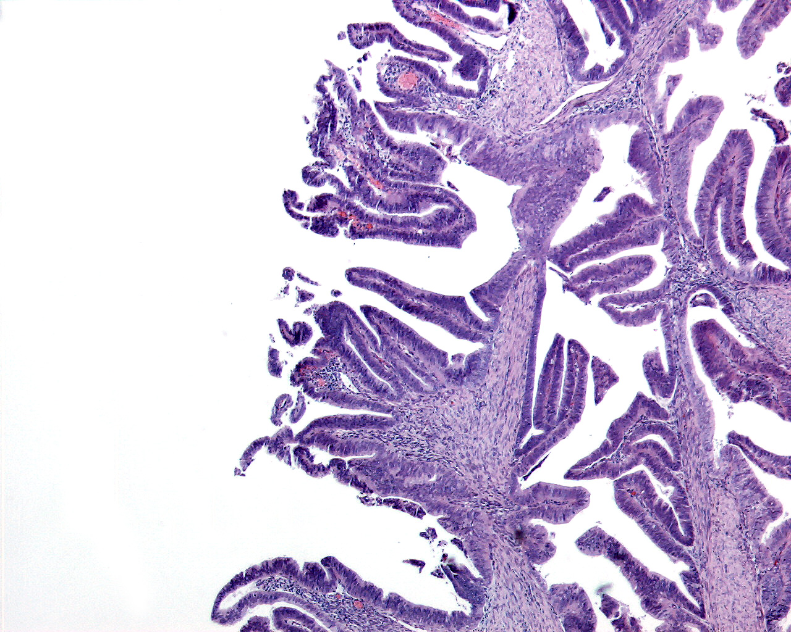
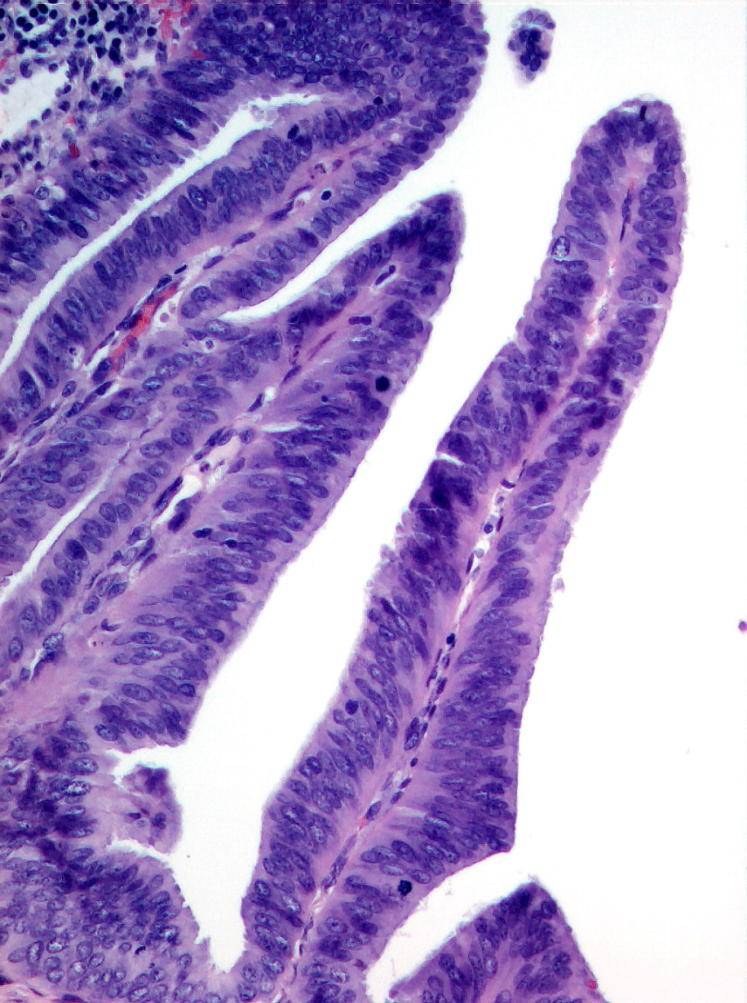
Endometrioid Carcinoma, Villoglandular Pattern
(Villoglandular Variant)
Slender Papillae
Low Grade Cytology

Slide 19
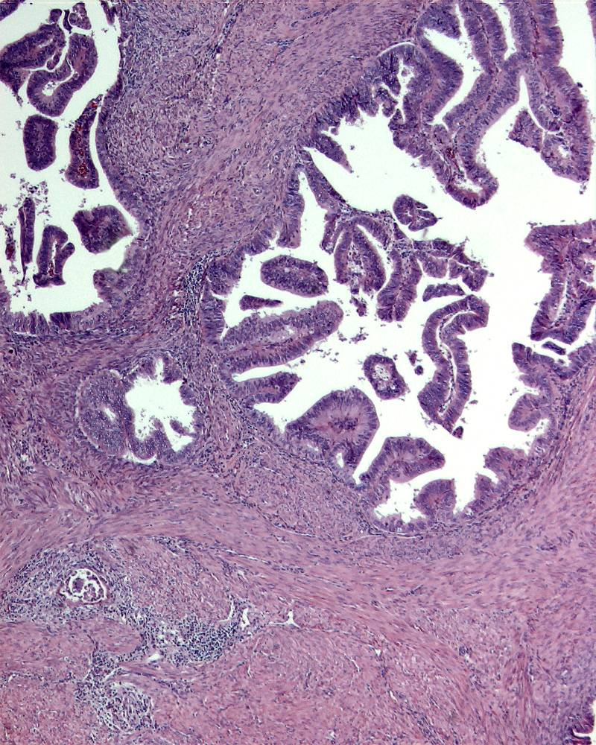
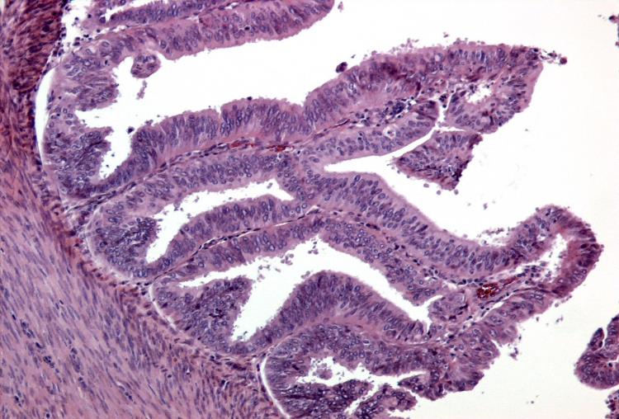
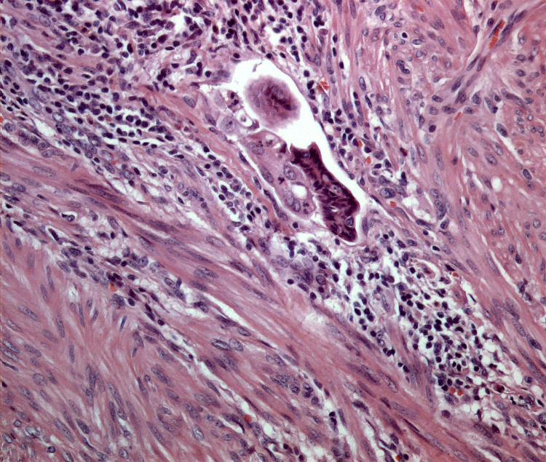
Villoglandular Pattern in Myoinvasive Adenocarcinoma

Slide 20
Endometrioid Carcinoma with a Villoglandular Pattern
Behavior
    If villoglandular pattern is present within the myoinvasive component of a tumor
      ↑ vascular/lymphatic invasion
      ↑ lymph node metastasis
    Behaves more aggressively than a typical endometrioid carcinoma
      Independent of grade and stage
Ambros RA, et al. (1994)

Slide 21
Papillary Endometrioid Carcinoma of Intermediate Grade (or Grade 2)
  Papillary
  endometrioid carcinoma of
  intermediate grade
  Endometrioid carcinoma with a villoglandular pattern
  Serous carcinoma
Not mentioned in the current WHO classification (2020)
Recognized by some gynecopathologists

Slide 22
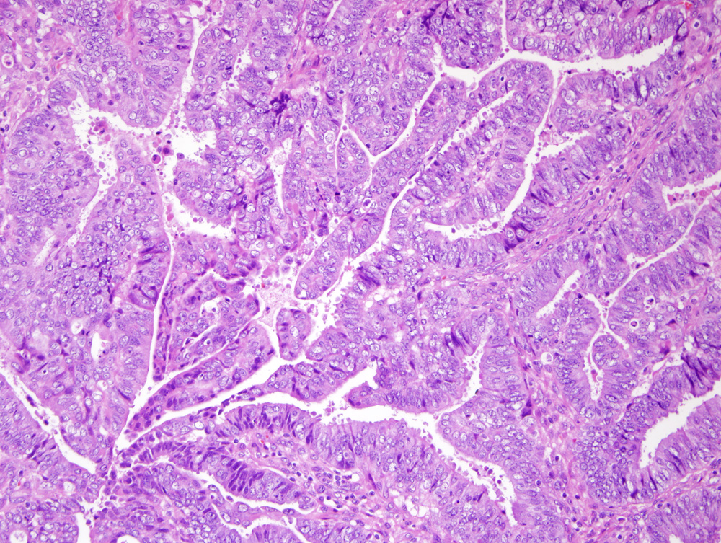
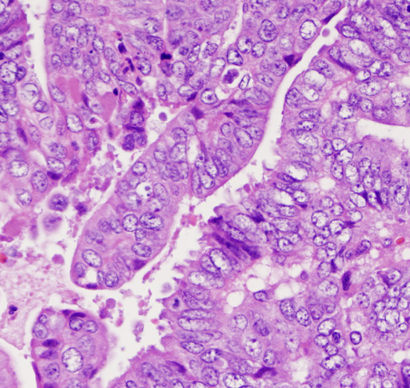

Slide 23
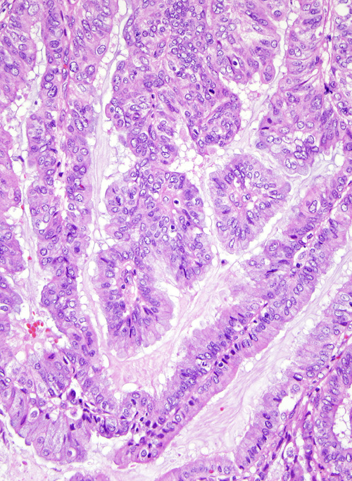
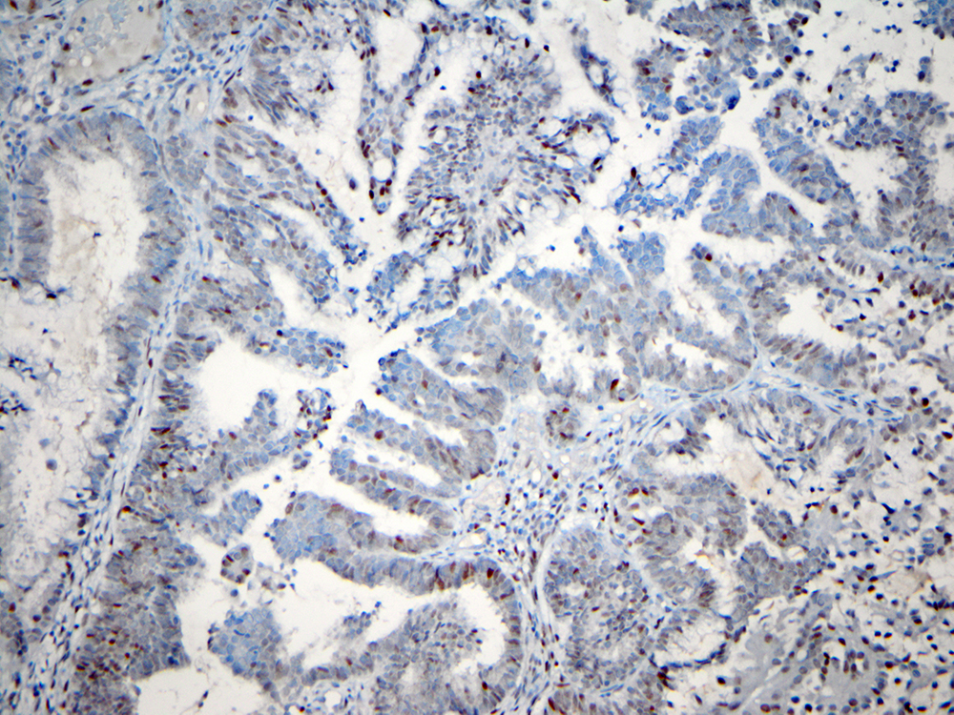
Mucinous Metaplasia
p53, wild pattern

Slide 24
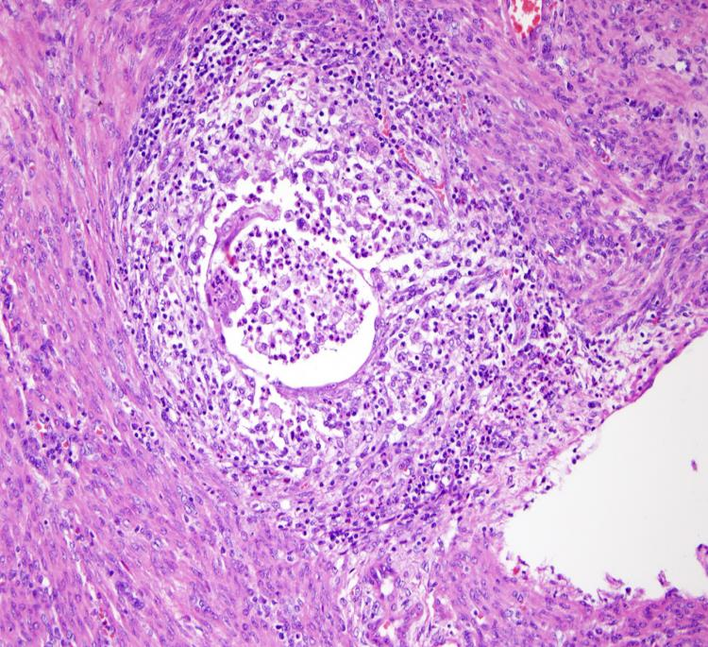
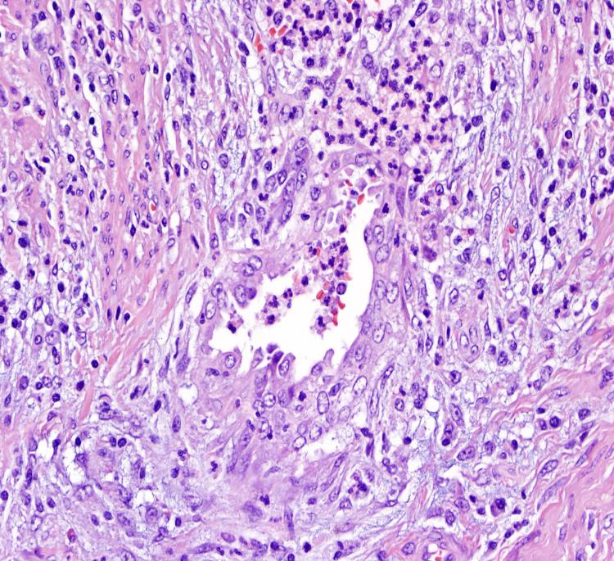
Papillary Endometrioid Carcinoma of
Intermediate grade
(or Grade 2) can be associated with a
MELF (Microcystic, ELongated and Fragmented)
pattern of invasion

Slide 25
Papillary Endometrioid Carcinoma of Intermediate Grade
Behavior
  Preliminary data appear to indicate that this type of tumor has
    ↑ incidence of vascular/lymphatic invasion
    ↑ lymph node metastasis

Slide 26
Clear Cell Carcinoma
Histology
It usually shows a combination of architectural patterns
Variable degree of cytology atypia
Discrepancy between the degree of atypia and mitotic index

Slide 27
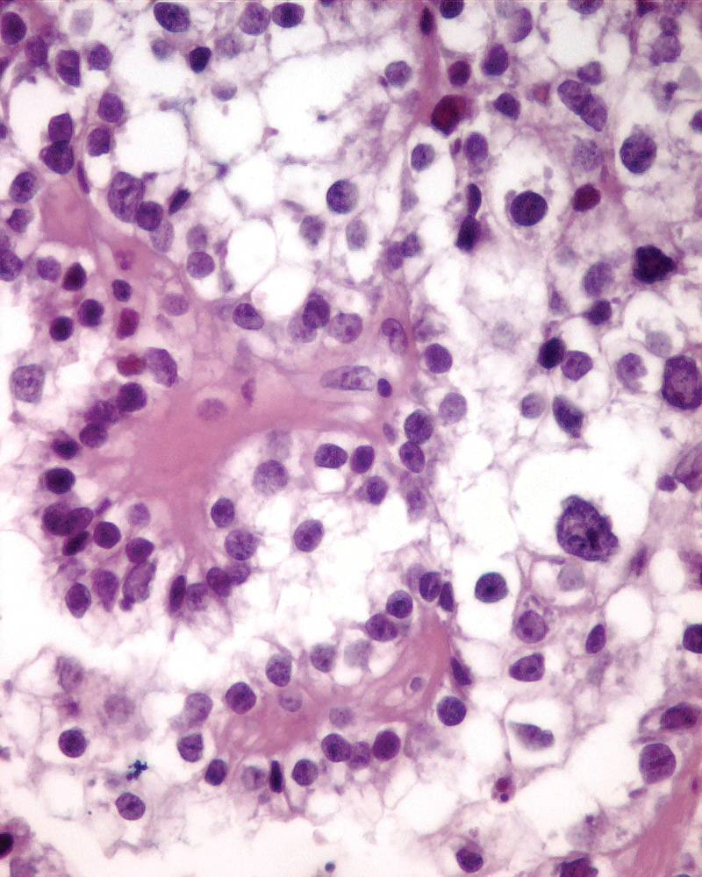
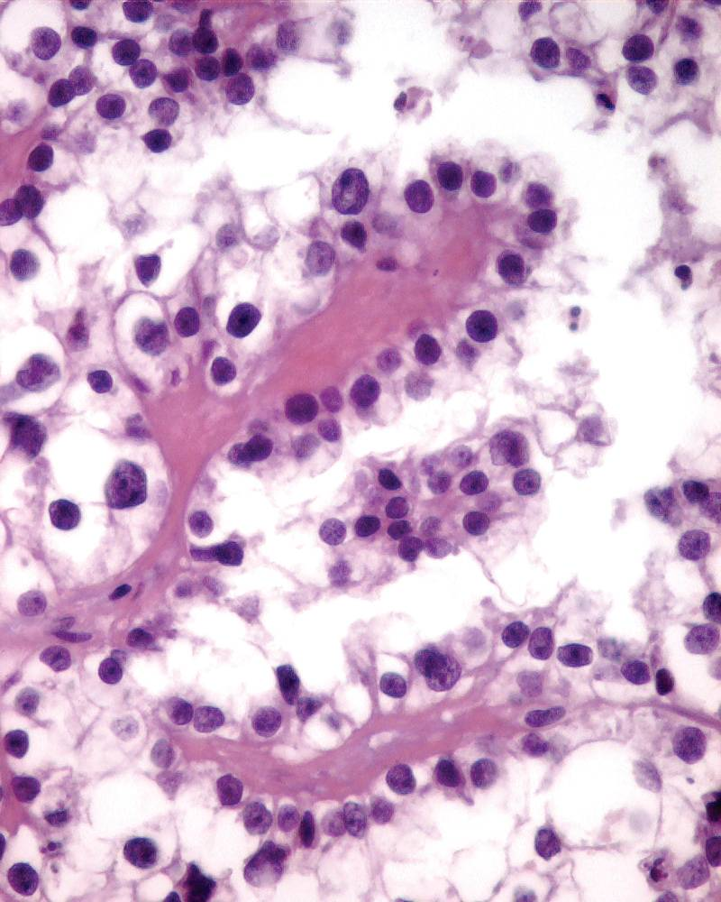
Clear cell carcinoma,
note variable degree of cytologic atypia, papillary pattern

Slide 28
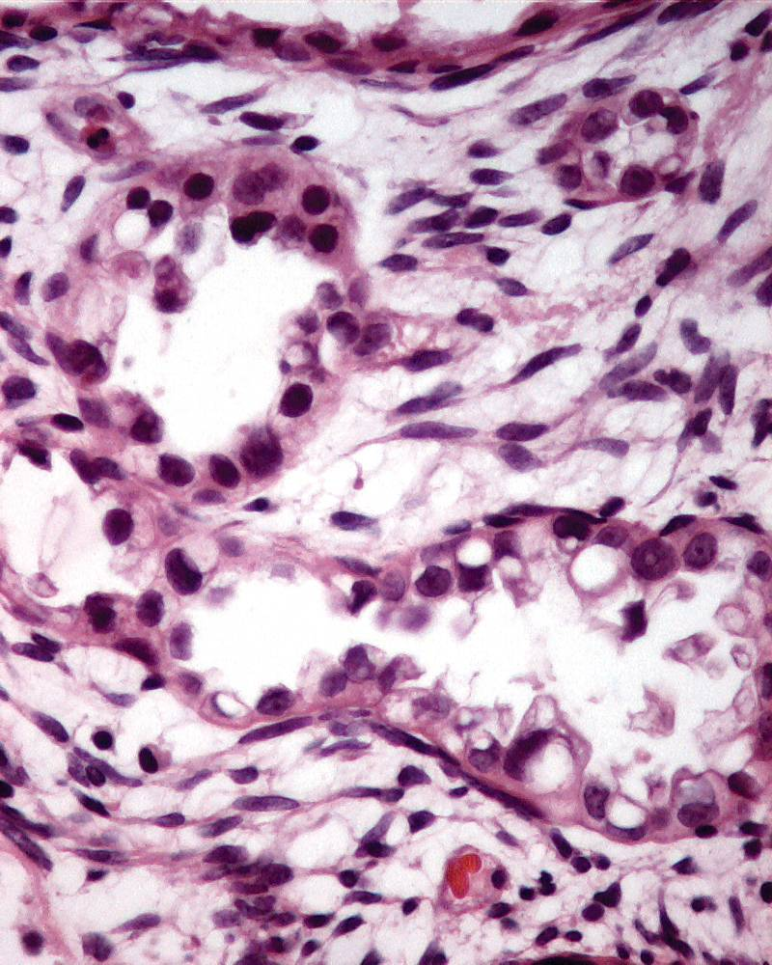
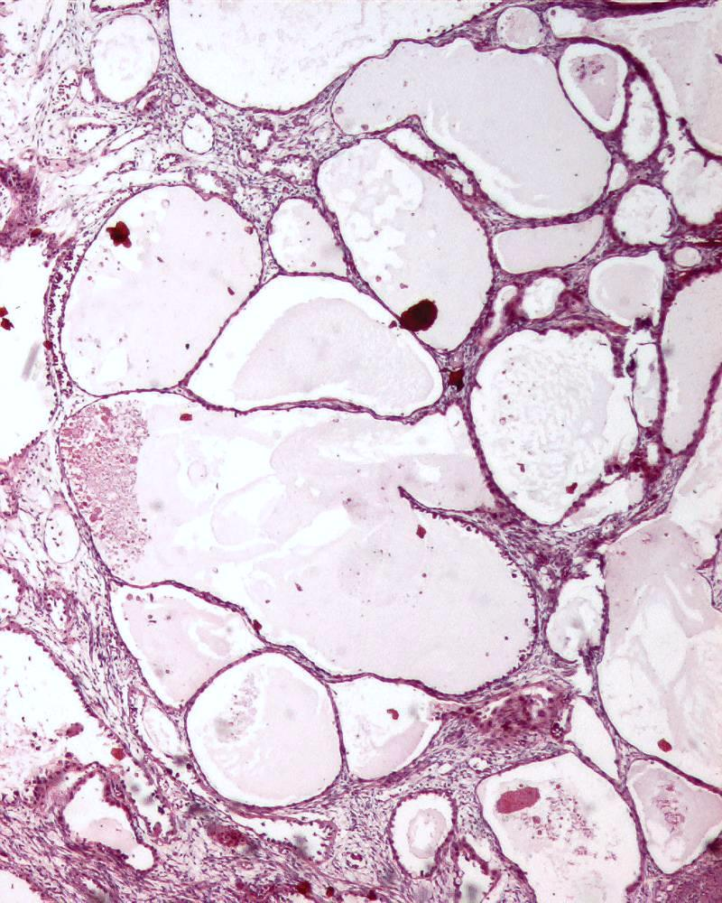
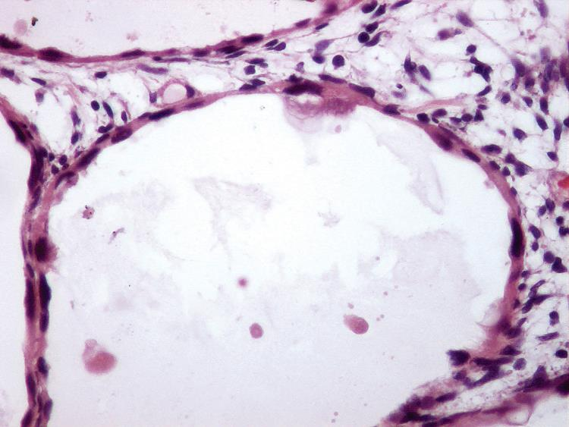
Clear cell carcinoma, tubulocystic pattern
Hobnail cells
Flattened epithelium with nuclear atypia

Slide 29
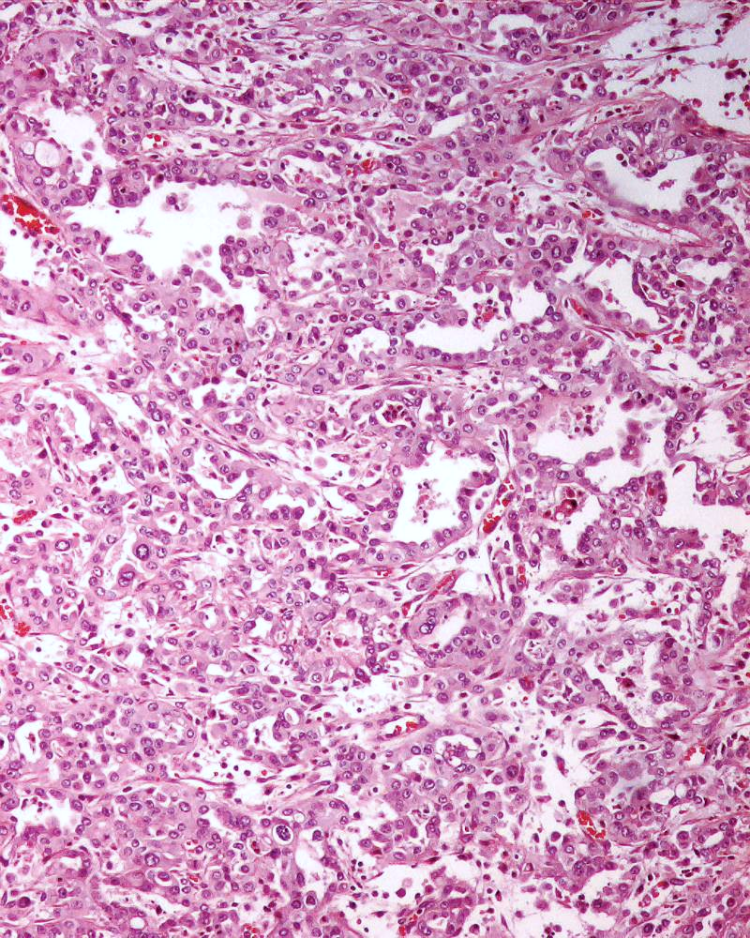
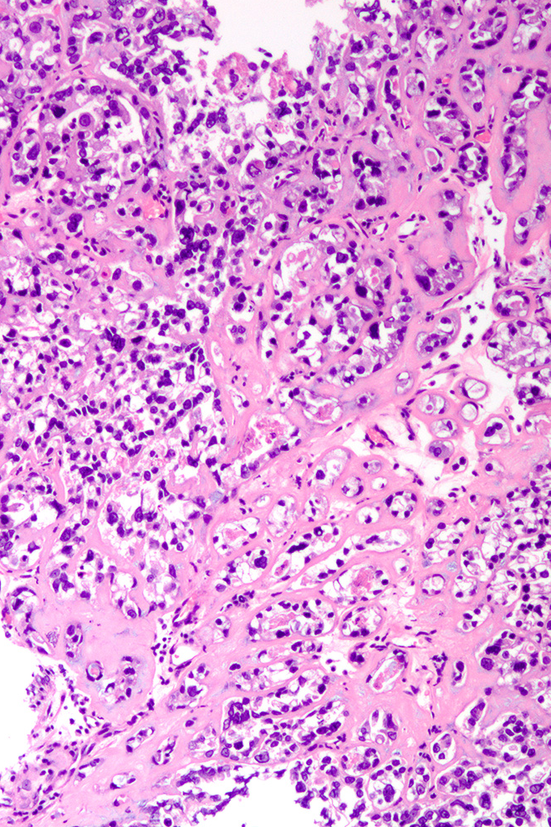
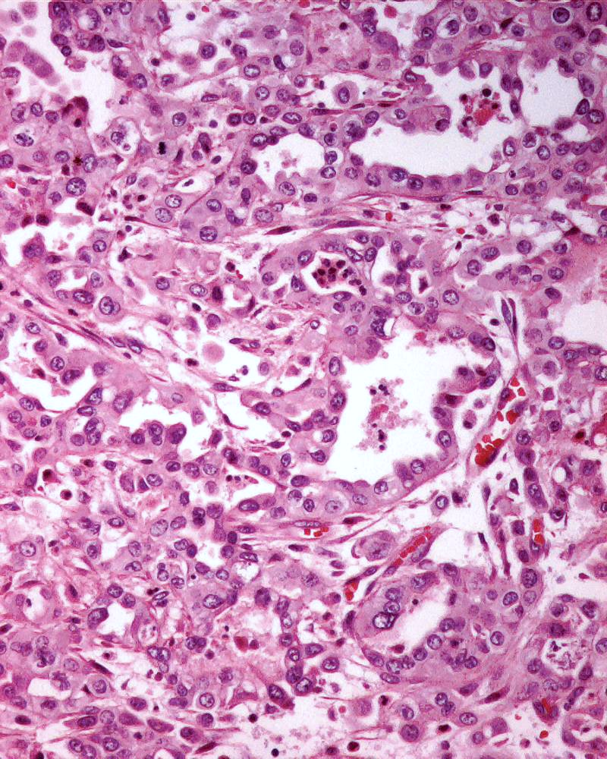
Clear cell carcinoma,
solid pattern and marked hyalinization of the stroma
Clear cell carcinoma, oxyphilic variant

Slide 30
Clear Cell Carcinoma
+
-
+/-
HNF-1β
Napsin
P504s
p16
  usually diffusely positive
PR
  usually negative
ER
  variable expression
p53
  variable expression

Slide 31
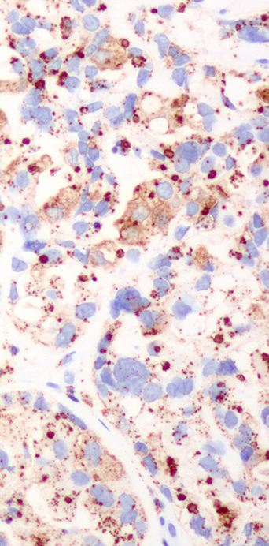
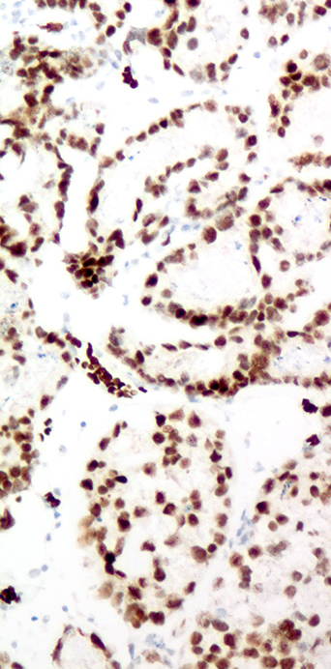
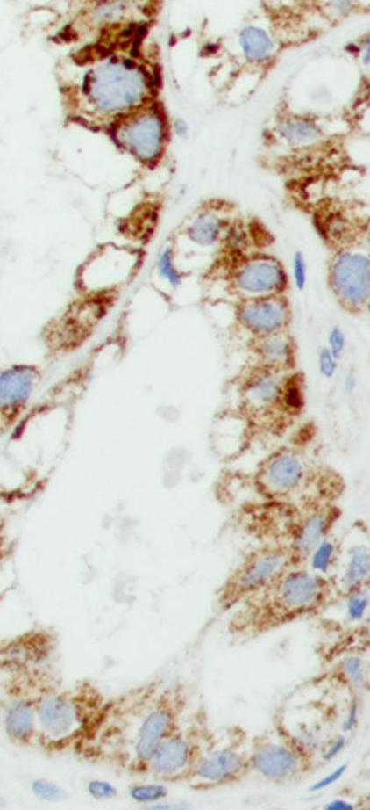
Clear Cell Carcinoma
Napsin +
HNF-1β +
p504S +

Slide 32


p53
p16

Slide 33





Napsin +
HNF-1B +

Slide 34





IUD related changes, pt with hx of atypical hyperplasia
Napsin +

Slide 35


Undifferentiated Carcinoma of the Endometrium

Slide 36


Undifferentiated carcinoma of the endometrium,
myxoid background

Slide 37




Undifferentiated Carcinoma:
Other Microscopic Features
Trabeculae
Rhabdoid cells
Spindle cells
V/L invasion

Slide 38
Undifferentiated Carcinoma
+/-
+/-
Ker cocktail expression is variable
  Usually patchy or focally +
  It tends to be completely (-) in pure undiff. Ca while diminished in dediff. Ca
  Up to 30% of cases show diffuse expression
Ker 18 better marker to enhance epithelial differentiation
p16
    34% D
NE markers +
    chromo and/or syn, F, <10%
SMARCA4 (BRG1) or SMARCB1 (INI-1, BAF47) +
  −in some cases
p53
    overexpressed in some cases

Slide 39
Undifferentiated Carcinoma
+
-
ZEB1 +
  nuclear expression
PAX-8
  80%
ER/PR
  >50% of the cases
E-cadherin
  50% of cases

Slide 40
Immunohistochemical Studies for DNA Mismatch Repair Proteins
(MLH1, MSH2, MSH6, PMS2)
They tend to show the loss of at least one mismatch repair protein
  More frequently loss of MLH1/PMS2
    Many tumors associated with MLH1 promoter methylation
  Sometimes loss of MSH2/MSH6 or PMS2
Broaddus RR, et al, 2006
Tafe LJ, et al, 2010
Stewart CJR, Crook ML, 2015
Ramalingam PR, et al, 2016

Slide 41


Dedifferentiated Carcinoma
Low Grade Endometrioid Ca
Undifferentiated Ca

Slide 42



Endometrioid Ca
Undifferentiated Ca
Ker 18
PAX-8
PAX-8

Slide 43

Dedifferentiated Carcinoma
Synchronous or metachronous phenomenon
Recognition of the metastases containing the undifferentiated carcinoma can be problematic
  Lack of cohesiveness of tumor cells
  PAX-8 negative

Slide 44


Small cell carcinoma

Slide 45


Small cell carcinoma
Chromogranin
Synaptophysin

Slide 46

Large Cell Neuroendocrine Carcinoma

Slide 47



Keratin (+)
Synaptophysin (+)
Chromogranin (+)

Slide 48
Neuroendocrine Carcinoma
(It can be mixed with other histotypes)
+
-
+/-
Ker cocktail and Ker 18 are usually +
diffuse or patchy
Syn expressed more frequently than chromo -CD56 can be expressed in endometrioid Ca (should not be used to confirm NE diff)
PAX-8
  67%
p16
  Can be diffusely positive
MMR proteins can be lost
  Usually MLH1/PMS2
  Less frequently MSH2/MSH6 or MSH6

Slide 49
Mucinous Carcinoma
>90 % of the tumor composed of mucinous epithelium
Architectural complexity
  Papillary, cribriform, glandular patterns
It can have bland cytological features
It can have abundant extracellular mucin
Rare cases with gastric or intestinal type differentiation

Slide 50

Mucinous Carcinoma

Slide 51




Vimentin
CEA
ER
p16

Slide 52
Mucinous Carcinoma
Immunohistochemical profile
  ER +
  PR +/-
  Vimentin can be only focally +
  CEA usually -
  p16 ( - ) or focally patchy +

Slide 53
Mesonephric-like Ca
Location
Uterine body
Ovary
Pts’ age
42 to 70 yrs
Mean, 60 yrs
Microscopic Features
Heterogeneous

Slide 54




Ductal
Papillary
Corded
Tubular
Solid
Retiform
Glomeruloid

Slide 55


Vesicular to clear nuclei
Nuclear grooves
Hobnail type cells
Eosinophilic secretions tubular pattern
Eosinophilic secretions ductal pattern
Eosinophilic secretions glandular structures with attenuated lining

Slide 56
Mesonephric-like Ca
IHC
PR
GATA-3
TTF-1
PAX-8
CD10
CK7
ER

Slide 57


Area with a predominant papillary pattern
Area with a predominant glandular pattern

Slide 58



Slide 59


Papillary areas with clear cells, eosinophilic cells, and hobnails

Slide 60




Vimentin, focally +
ER/PR neg
p53 “wild- type”
ER/PR neg

Slide 61




p16 patchy +
GATA-3 +
Ki-67 index: low
GATA-3 +

Slide 62
NGS
Kras mutations
PIK3CA mutations
Behavior
Aggressive
Lung metastasis
ARID1A mutations

Slide 63



