Slide 1



Surgical Pathology of Ampulla
N. Volkan Adsay, MD
Professor of Pathology
Chair, Surgical Sciences
Chair, Dept. of Pathology
Koç University
Department of Pathology
Istanbul, Türkiye

Slide 2
“Ampulla”: Definitional issues

Slide 3
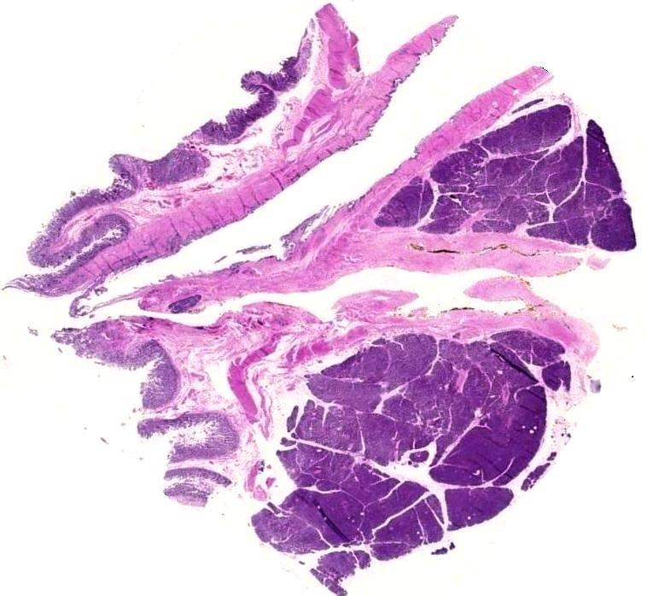
Most studies on the topic are published under the heading of “periampullary”, a term that has been used variably as
All Whipple-ables
Ampulla and its vicinity
Ampulla itself, strictly
Non-ampullary duodenum

Slide 4
AMPULLARY CARCINOMA
Definition:
1. Epicenter of the tumor is at the ampulla.
2. Location of the precursor lesion, if there is one and if it is convincing, is at the ampulla.
3. > 75% of the mass is at the ampulla.

Slide 5
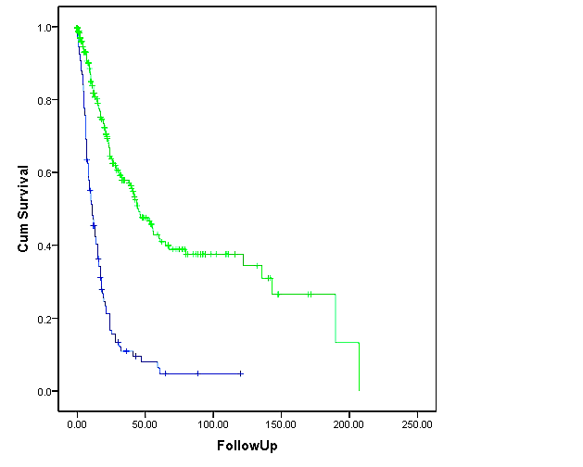
Defined as such, ampullary carcinomas, overall have a much better prognosis than pancreatic ductal adenocarcinomas
Log rank p-value <0.0001
Ampullary carcinomas (n=289)
Panc-ductal ca (n=113)

Slide 6
AMPULLA HISTOLOGY/ANATOMY

Slide 7
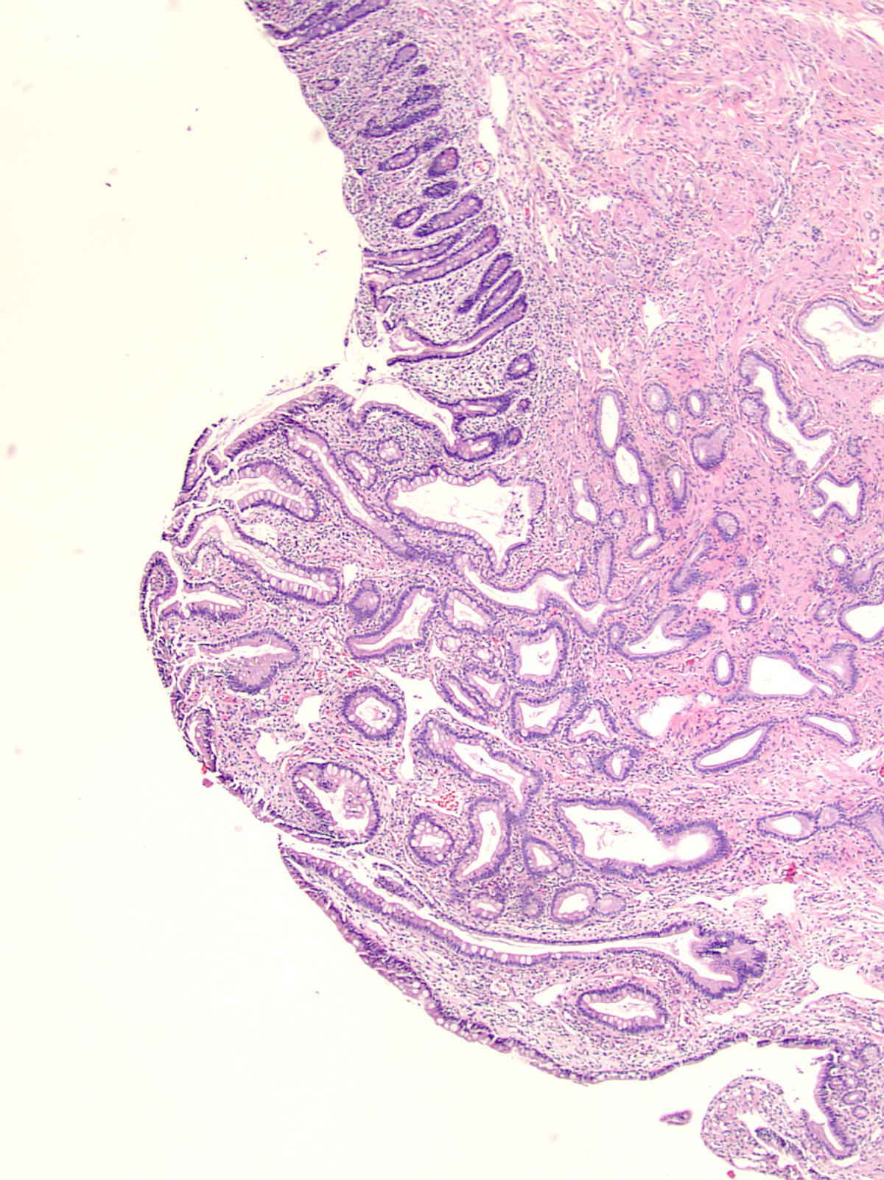
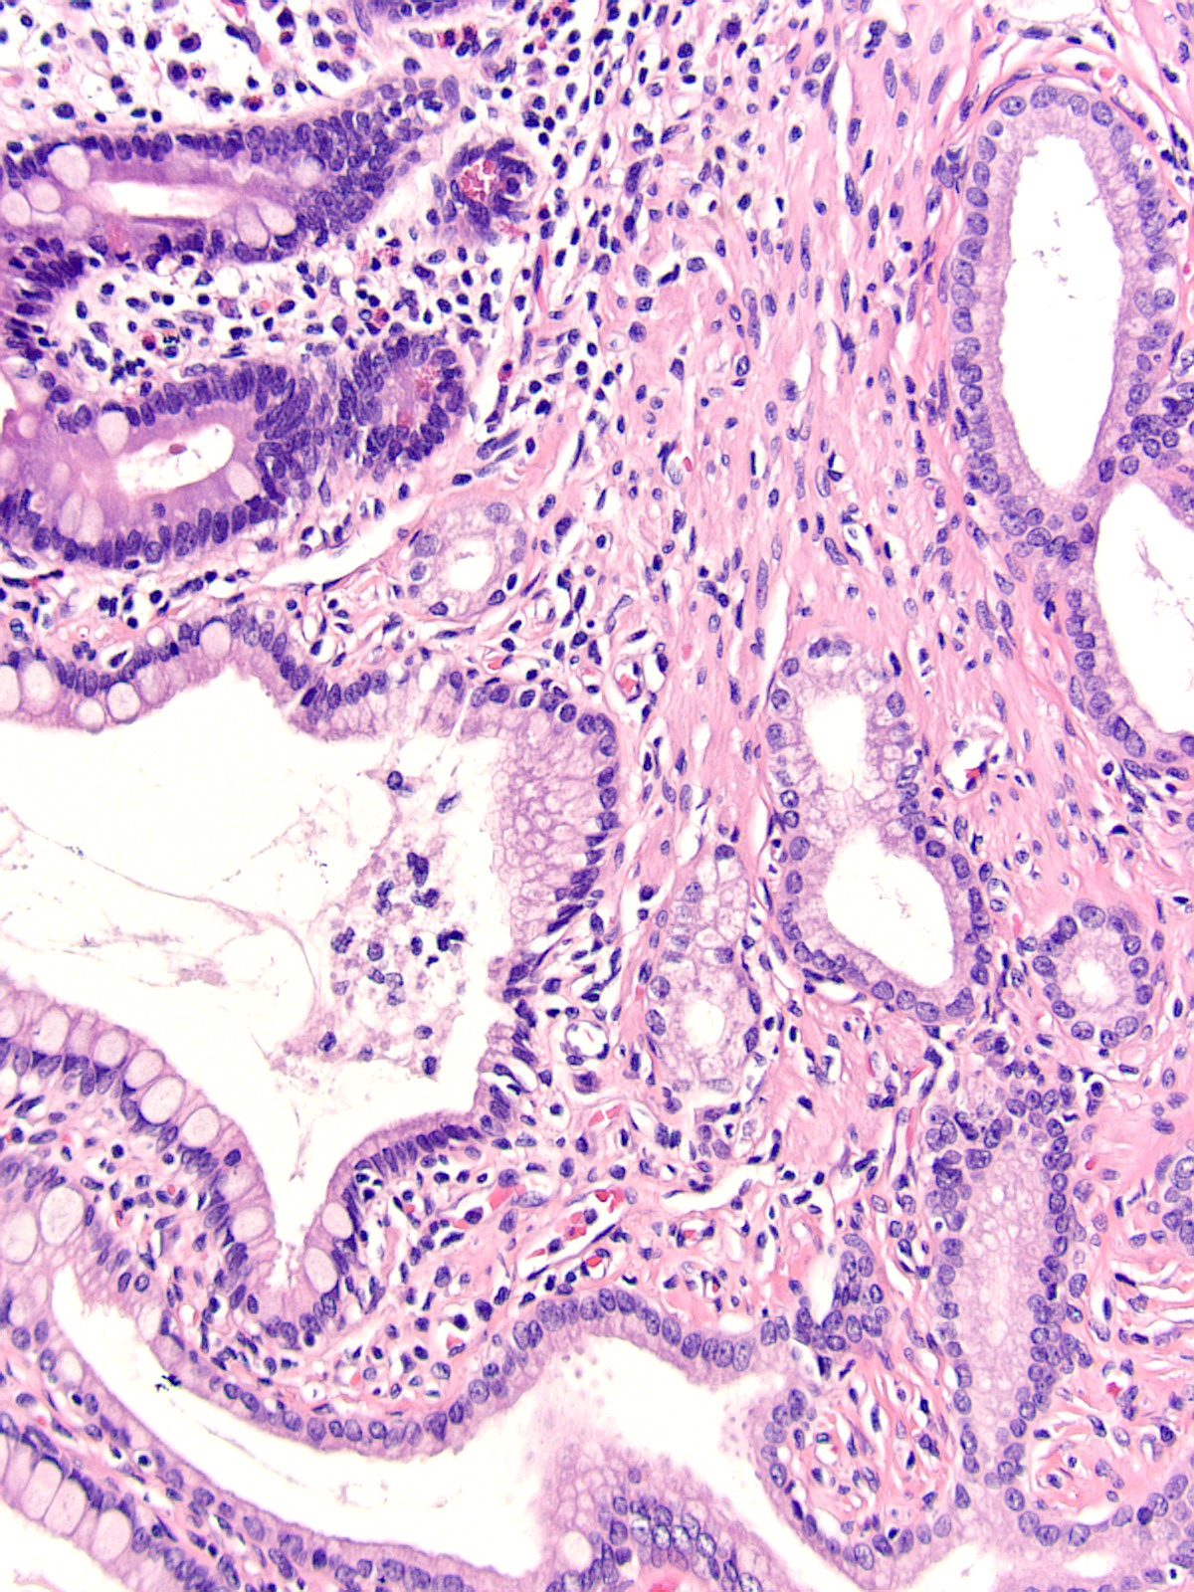
Intestinal-type mucosa
Ducts
Hybrid epithelia
Notes:
This complexity is also reflected at the histologic level with intestinal type mucosa transforms into a hybrid mucosa of the Papilla of Vater showing goblet cells in foveolar-like epithelium, and admixed with ductules of the type that are seen in pancreatobiliary tract

Slide 8
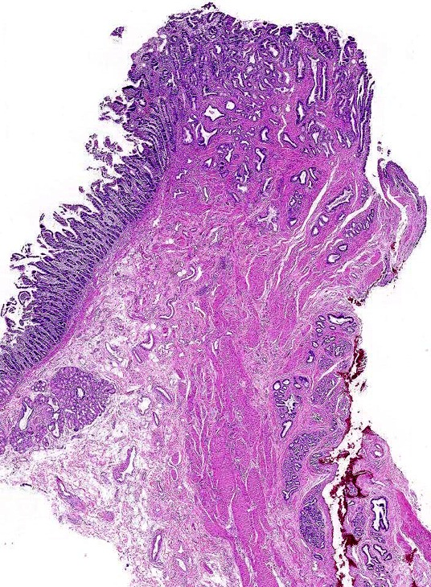
3. Ampullary-duodenum
2. Ampullary-ductules
4. Papilla of Vater
1. Intraampulary mucosa / Distal ends of the CBD and MPD

Slide 9
CAP synoptic protocol / WHO -2019
Intra-ampullary
Intra-ampullary papillary tubular neoplasm
Ampullary-ductal
Peri-ampullary
3. (Peri)ampullary-duodenal (duodenal surface of the papilla)
4. Mixed
3. Ampullary-duodenum
2. Ampullary-ductules
4. Papilla of Vater
1. Intraampulary mucosa / Distal ends of the CBD and MPD

Slide 10
Case - History
73, F
Abdominal pain and jaundice
Cholangiogram: “Density in the distal CBD”
Sphincterotomy: Extricated a polypoid mass into the duodenal lumen; stent was placed
Pancreatoduodenectomy was performed

Slide 11
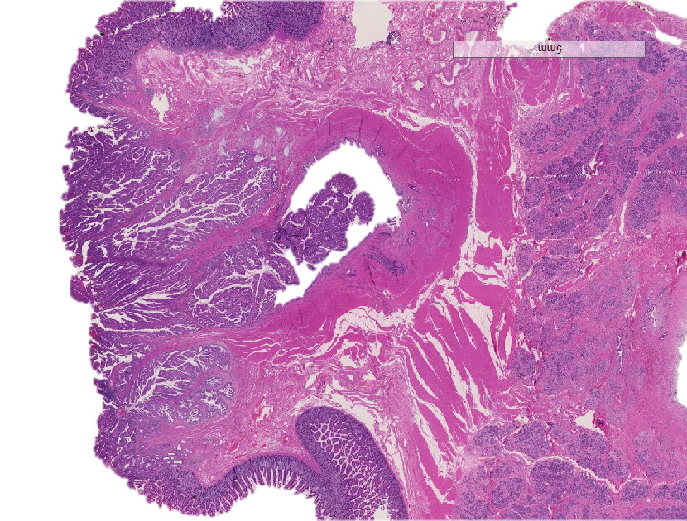
Papillary/polypoid lesion filling the ampullary channel
(distal ends of CBD and MPD)
Fig. 1
Ampulla
Oddi musculature
Pancreas
Duodenal muscularis propria

Slide 12
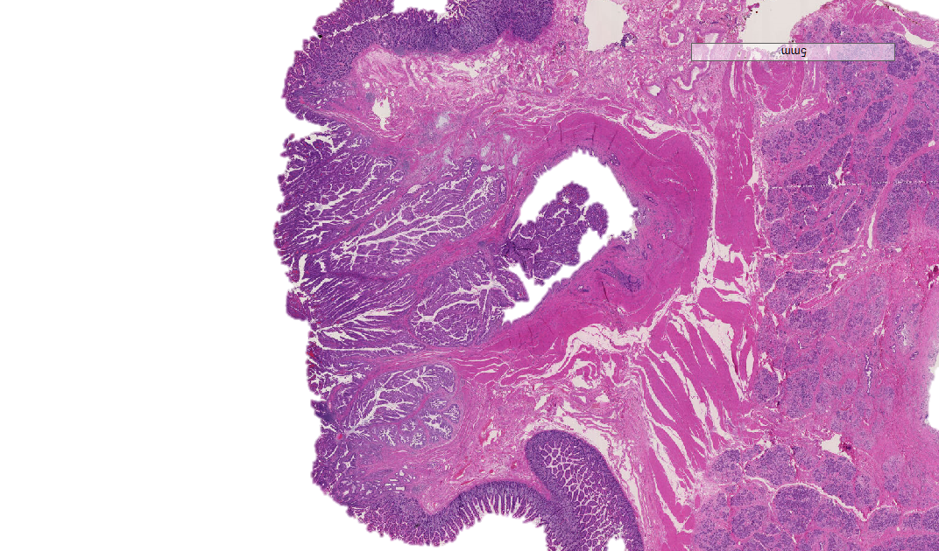
…While preserving the duodenal surface of the ampulla
Fig. 1
Papilla of Vater: Dilated
Pancreas
Oddi musculature
Duodenal muscularis propria

Slide 13
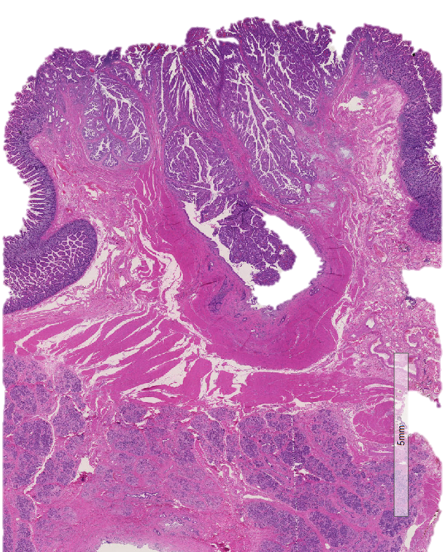
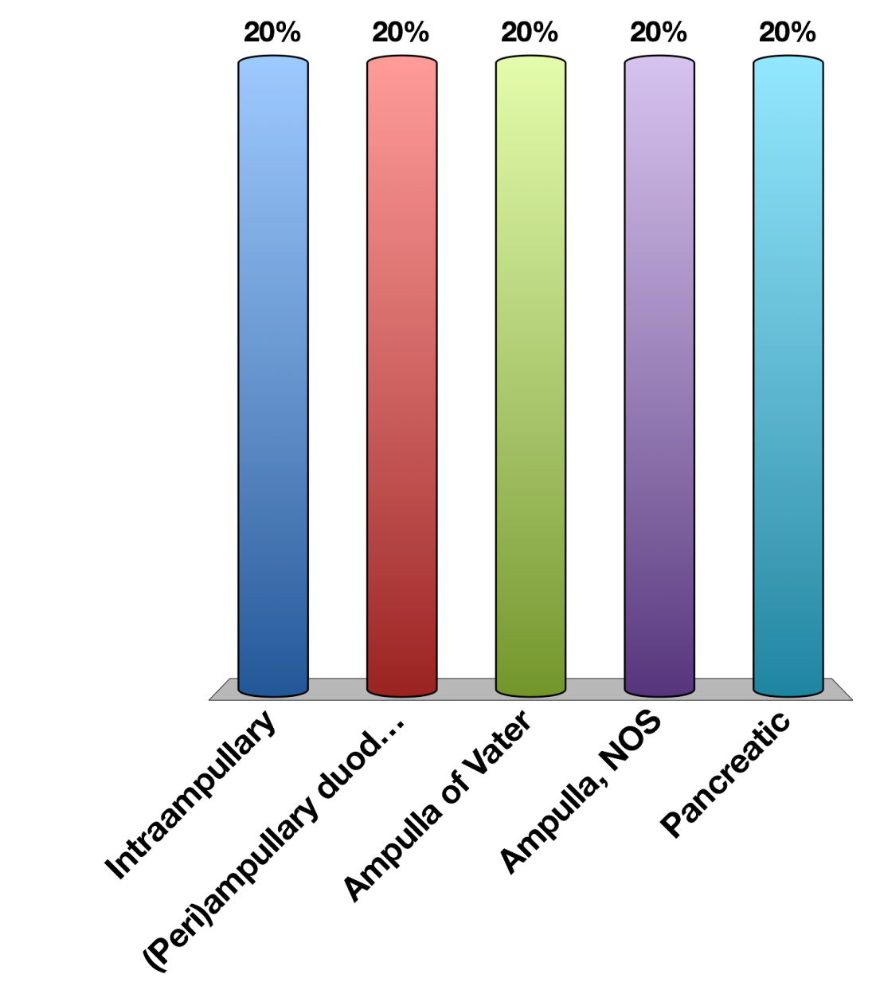
Which category does this belong to?
Intraampullary papillary tubular neoplasm (IAPN)
(Intraampullary), ampullary-ductal type
(Peri)ampullary duodenal
Ampulla of Vater (NOS) / Mixed
Pancreatic

Slide 14
Which category does this belong to?
Intraampullary papillary tubular neoplasm (IAPN)
(Intraampullary), ampullary-ductal type
(Peri)ampullary duodenal
Ampulla of Vater (NOS) / Mixed
Pancreatic

Slide 15
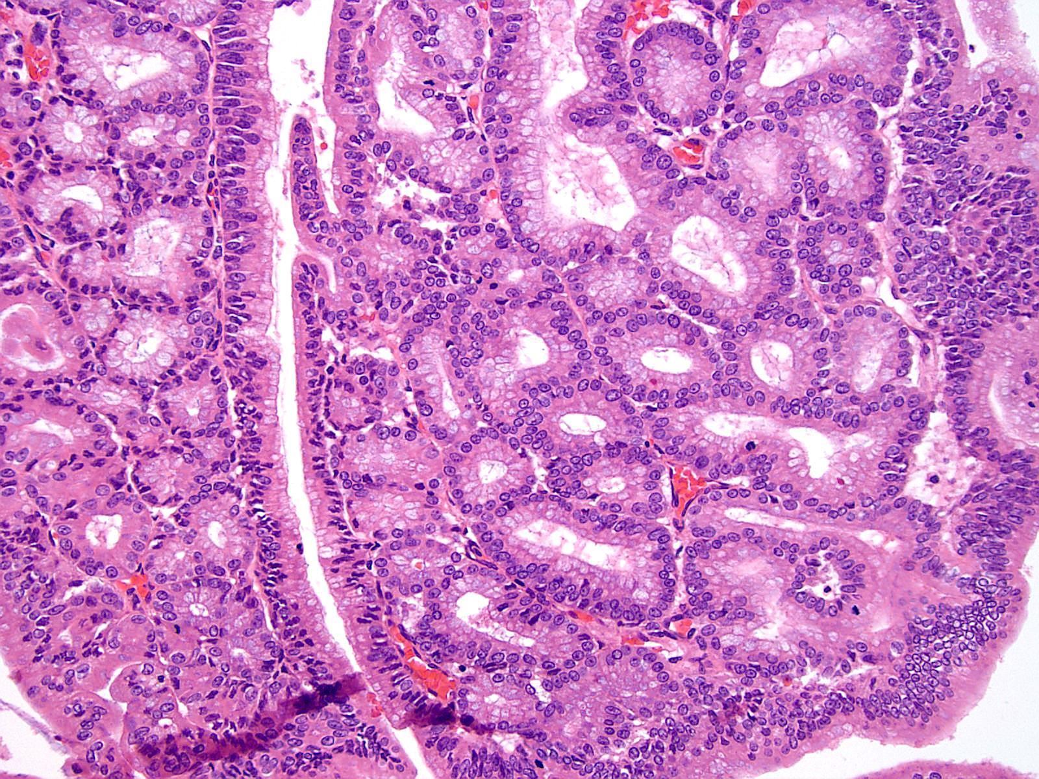
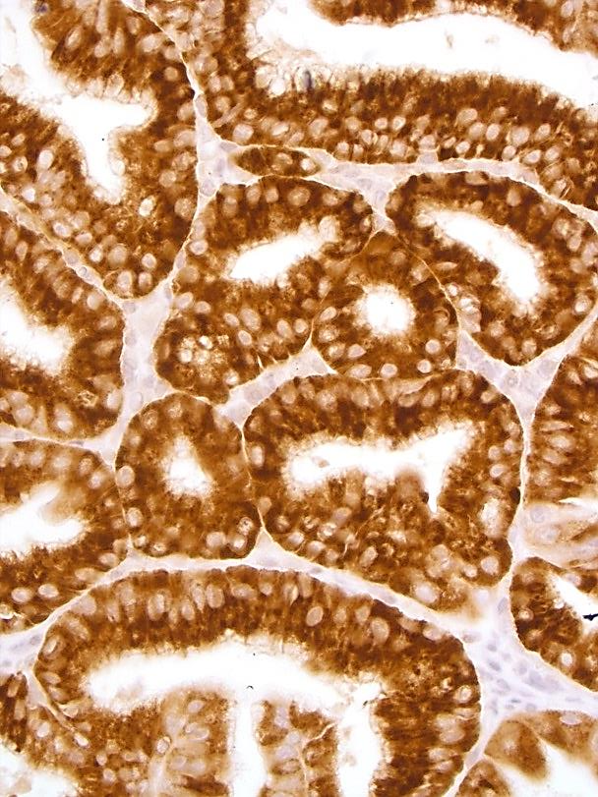
The tumor within the ampulla had foci with
tubular pyloric gland pattern
MUC6

Slide 16
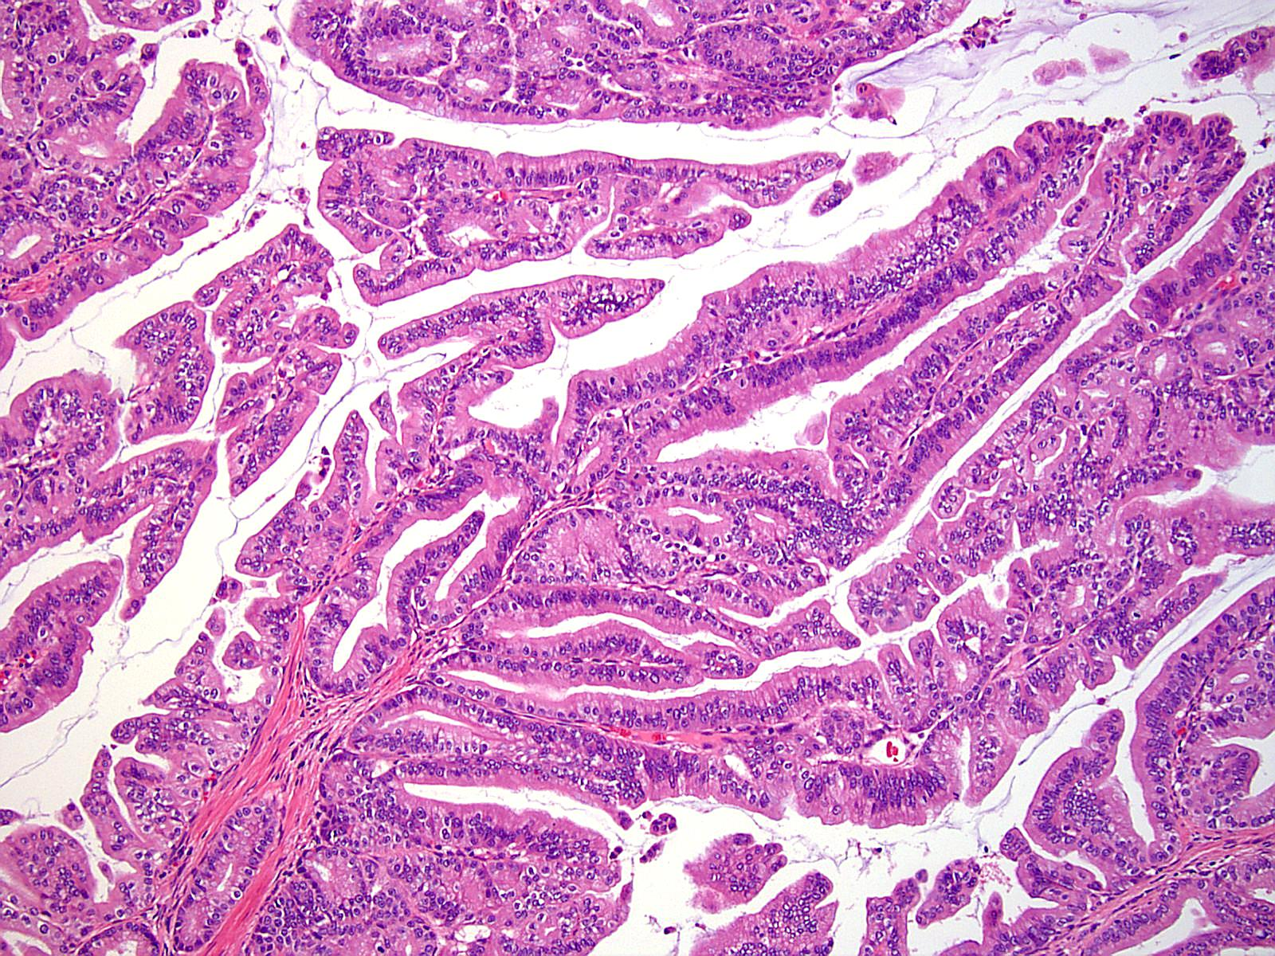
But also papillary areas

Slide 17
Dgn:Intra-ampullary papillary tubular neoplasm with high-grade dysplasia (CIS)

Slide 18
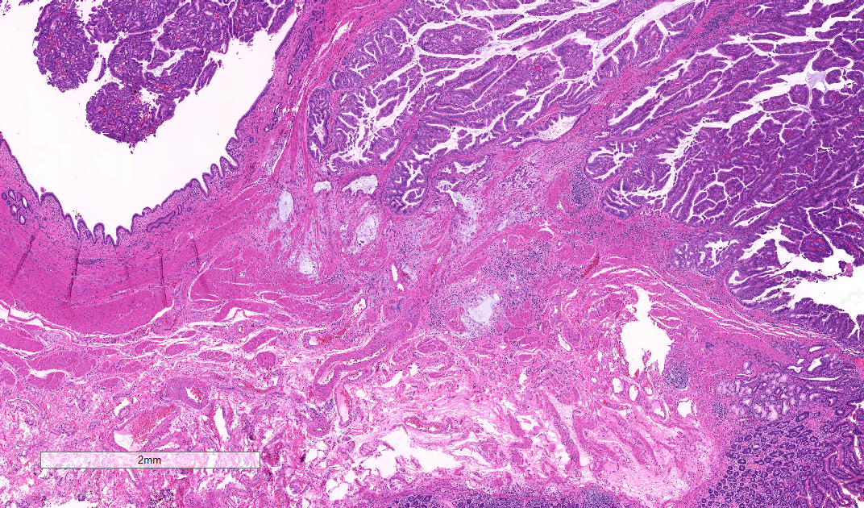
In recuts this 3-mm focus was discovered

Slide 19
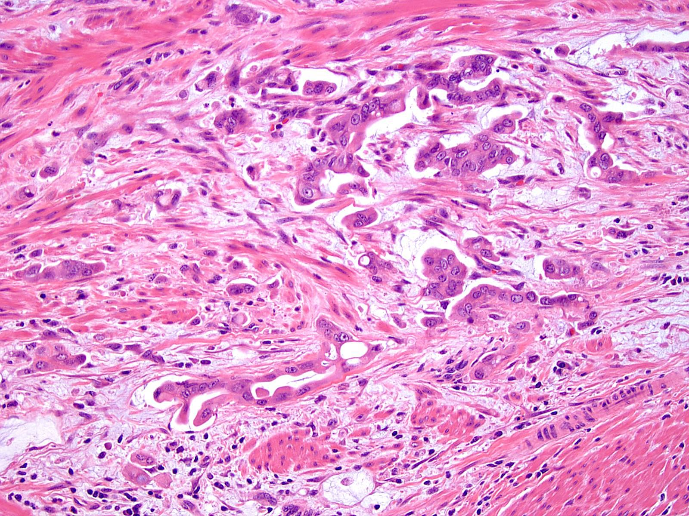

Slide 20
Formal diagnosis of the case
Ampulla, pancreas, CBD; pancreatoduodenectomy:
Invasive adenocarcinoma of the ampulla, minute focus of (estimated size, 3 mm), arising in intra-ampullary papillary tubular neoplasm.
Invasive carcinoma is high-grade with pancreatobiliary features.
IAPN component is gastro-pancreatobiliary type, with tubulopapillary pattern.
Suspicious vascular invasion is present.

Slide 21
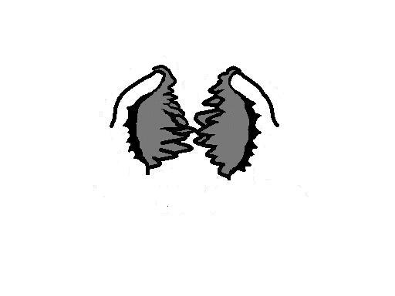
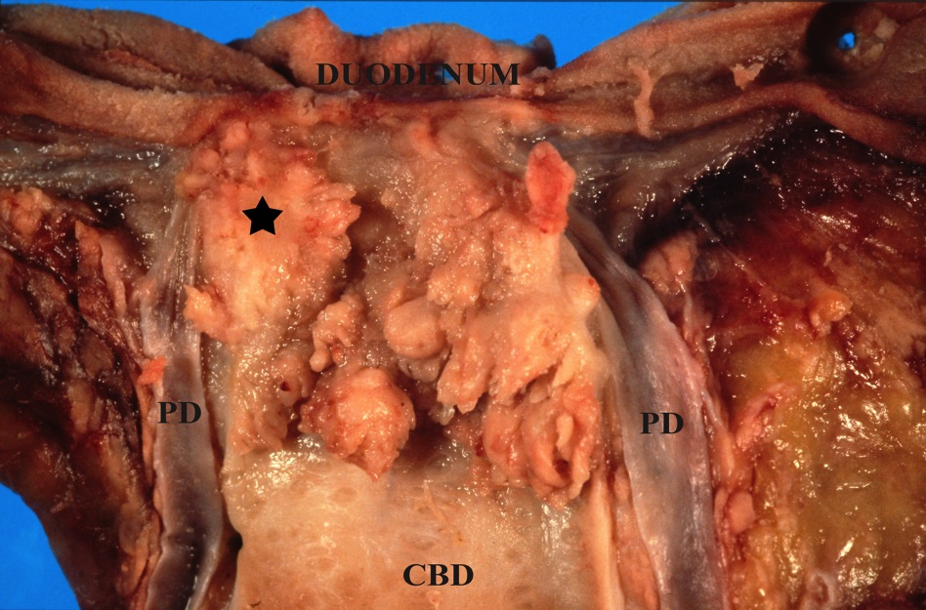
INTRA-AMPULLARY
PAPILLARY
TUBULAR
NEOPLASMS
CBD
Notes:
Intra-AMP group was distinguished by a prominent intraluminal growth of preinvasive neoplasia within the ampulla, often with dilated orifice of Vater from which nodules could protrude into the lumen and could show some pagetoid extension to the adjacent duodenal mucosa, but by definition > 75% of the preinvasive lesion was within the ampulla

Slide 22
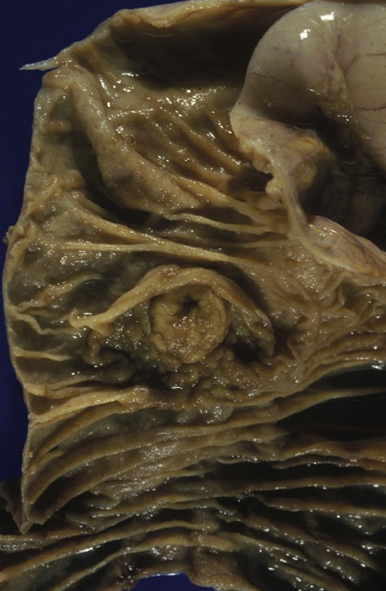

Slide 23
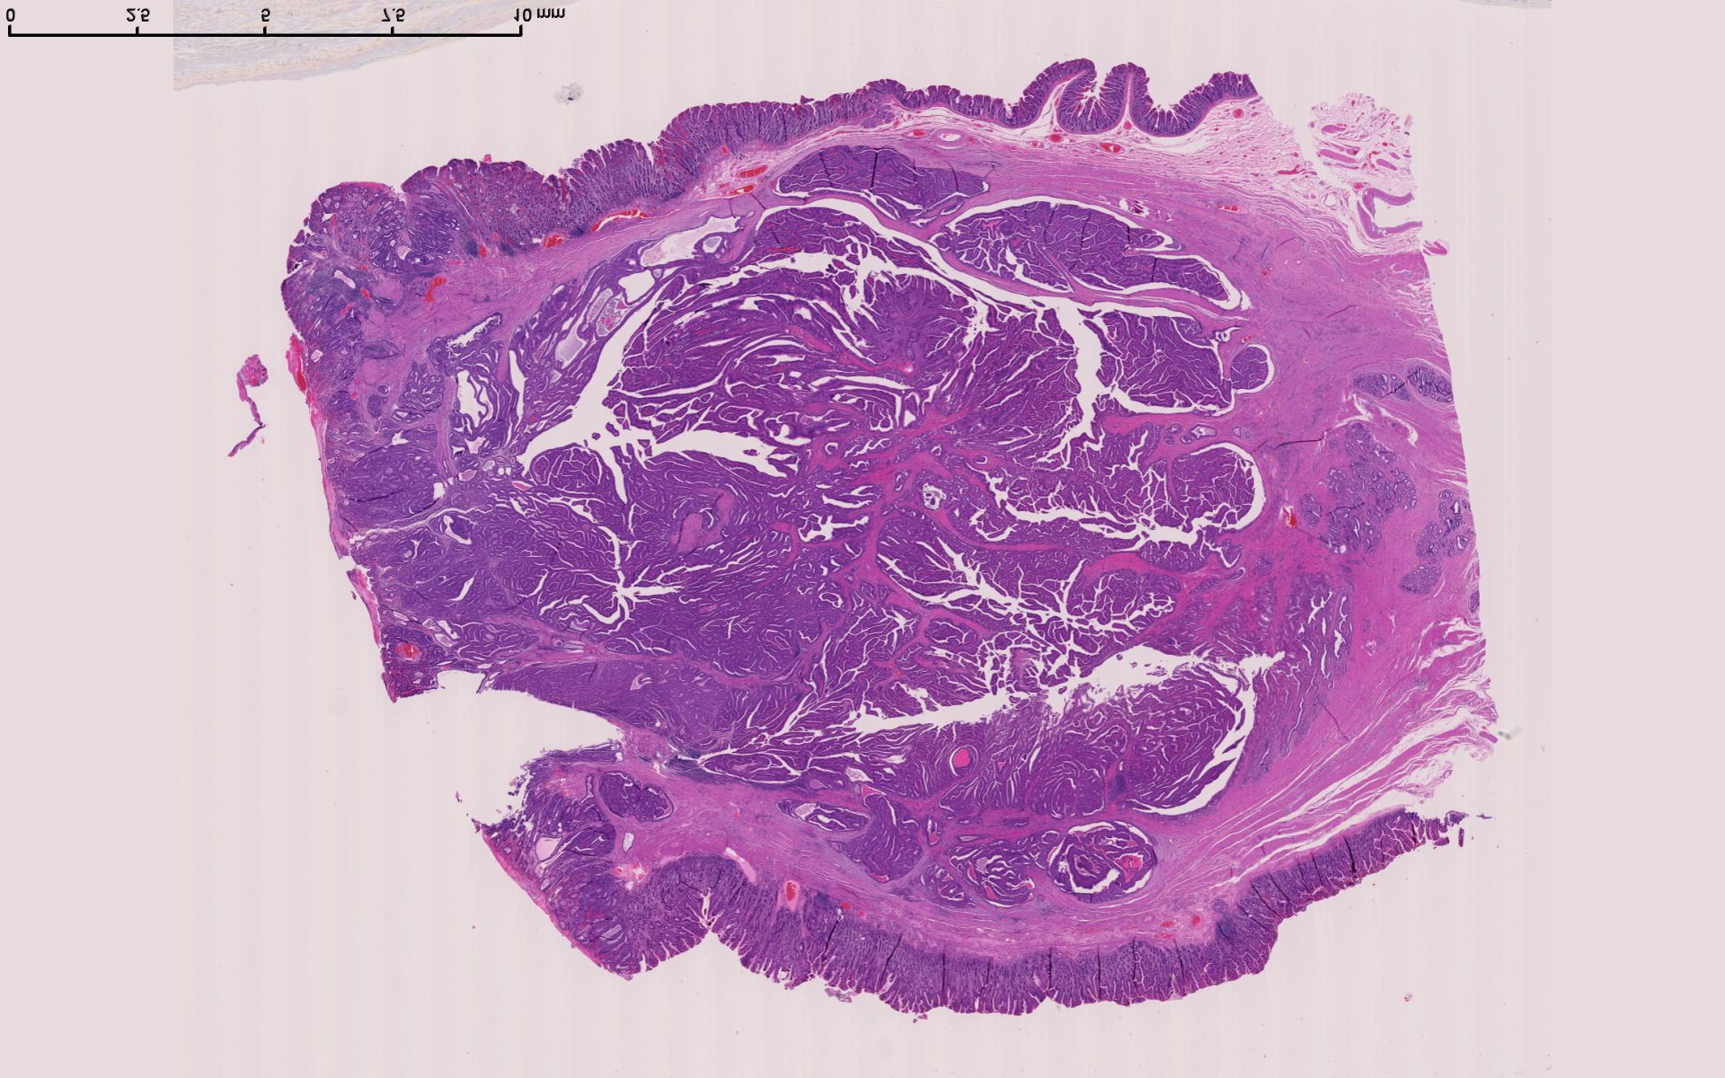
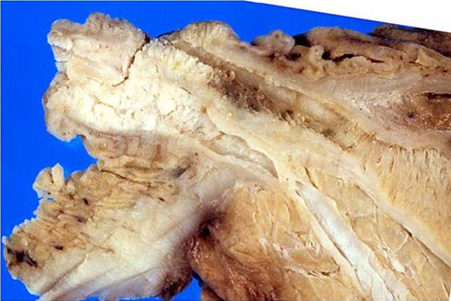
INTRA-AMPULLARY PAPILLARY TUBULAR NEOPLASM
PD
CBD

Slide 24
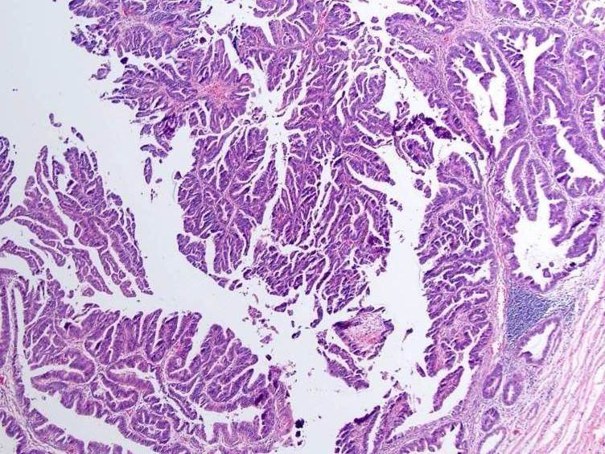
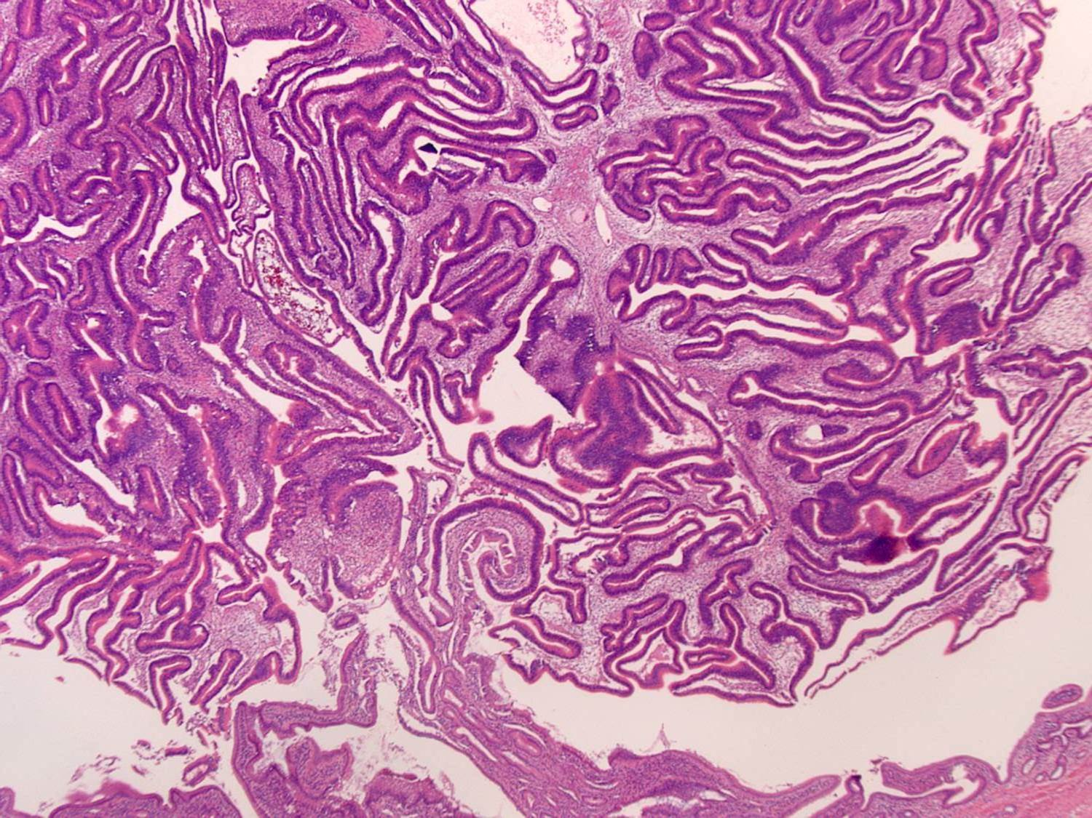
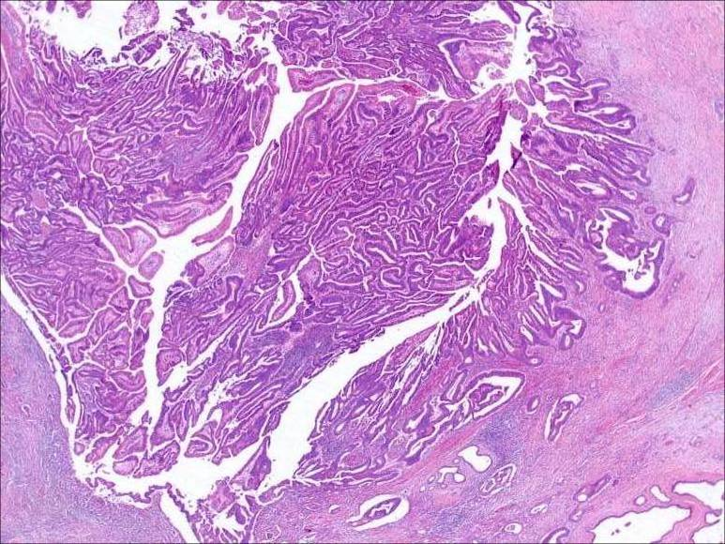
Spectrum of growth patterns
Papillary
Tubular
Tubulo-papillary
Notes:
Histologically, IAPN shows papillary, tubular, or papillo-tubular growth.

Slide 25
Case for discussion
66, M
Radiologic/clinical dgn: “ampullary tumor”
Underwent pancreatoduodenectomy
Notes:
The third category is what we proposed to call Amp-ductal. These were subtle tumors that formed schirrous constrictive lesions on the walls of the very distal tips of CBD and/or MPD. Typically, if present, the preinvasive neoplasm was minimal and of flat type. These tumors were very underwhelming when examining from the duodenal perspective, showing button like elevetions with a central dimple like depression, and in some cases with ulceration.

Slide 26
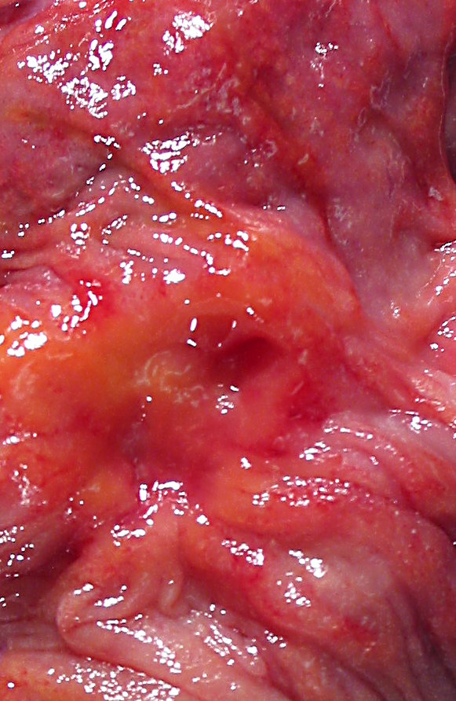
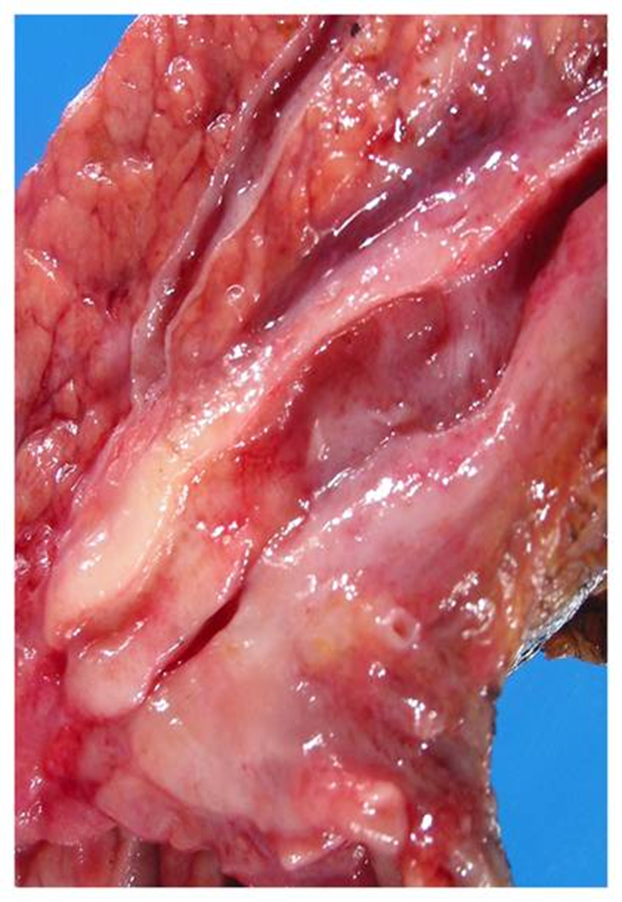
Appearance from duodenal aspect
Pancreatic duct
CBD
POV
Appearance, cut surfaces
Notes:
The third category is what we proposed to call Amp-ductal. These were subtle tumors that formed schirrous constrictive lesions on the walls of the very distal tips of CBD and/or MPD. Typically, if present, the preinvasive neoplasm was minimal and of flat type. These tumors were very underwhelming when examining from the duodenal perspective, showing button like elevetions with a central dimple like depression, and in some cases with ulceration.

Slide 27
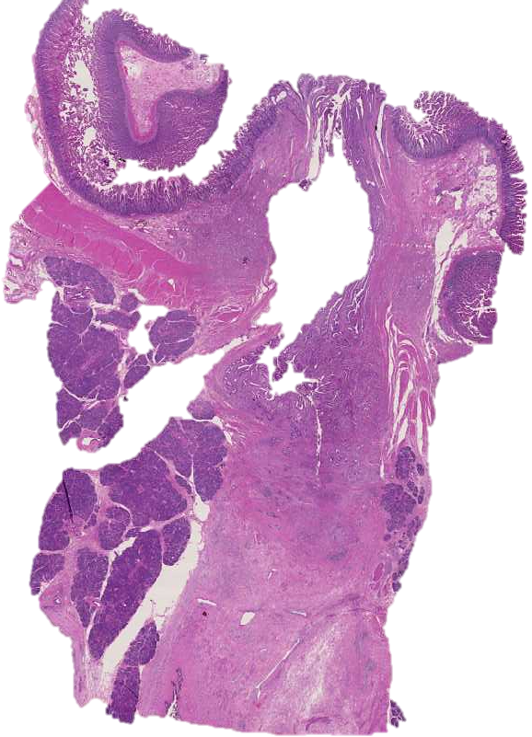
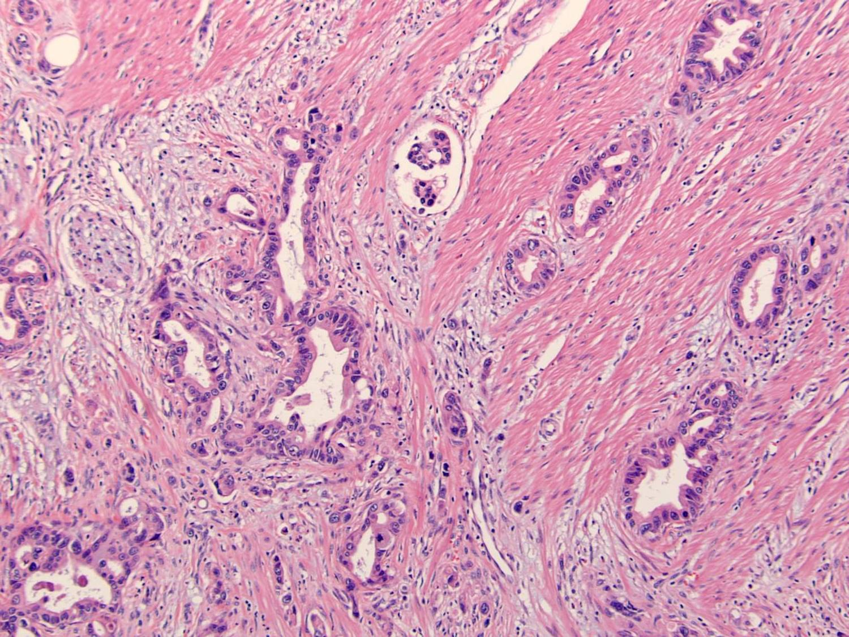
POV
PD
CBD

Slide 28
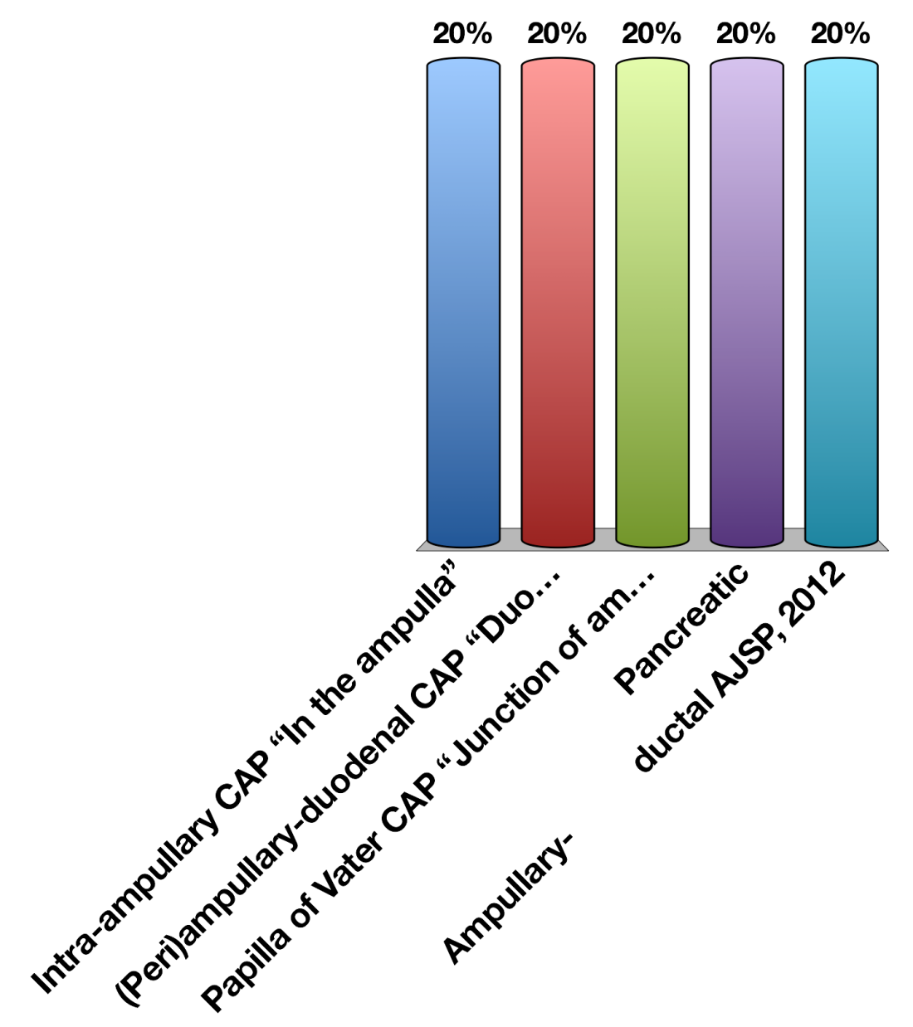
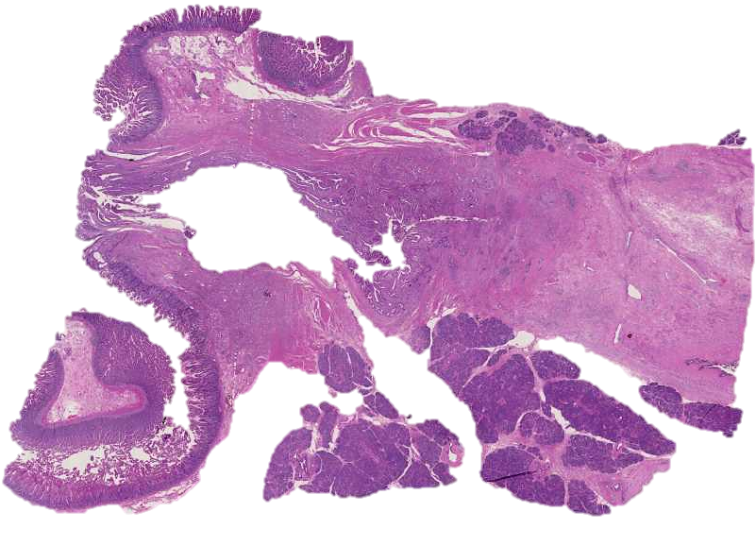
What is the origin (site specific classification) of this tumor?
POV
Intra-ampullary, IAPN associated
Ampullary- ductal
(Peri)ampullary-duodenal
Pancreatic
Mixed
PD
CBD

Slide 29
What is the origin (site specific classification) of this tumor?
POV
Intra-ampullary, IAPN associated
Ampullary- ductal
(Peri)ampullary-duodenal
Pancreatic
Mixed
PD
CBD

Slide 30
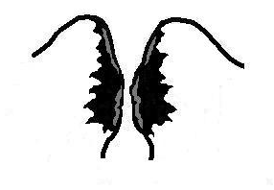
PD
AMP-DUCTAL: 15%
CBD
Appearance from duodenal aspect
POV
Notes:
The third category is what we proposed to call Amp-ductal. These were subtle tumors that formed schirrous constrictive lesions on the walls of the very distal tips of CBD and/or MPD. Typically, if present, the preinvasive neoplasm was minimal and of flat type. These tumors were very underwhelming when examining from the duodenal perspective, showing button like elevetions with a central dimple like depression, and in some cases with ulceration.

Slide 31

Ampullary-ductal
Relatively older patients
90% are ductal type (pancreatobiliary) by histology
Relatively small
(mean, ~ 1.7 cm)
However; the most aggressive
High stage, high LN mets
Worst prognosis (3-yr, ~32%)
POV
PD
CBD

Slide 32
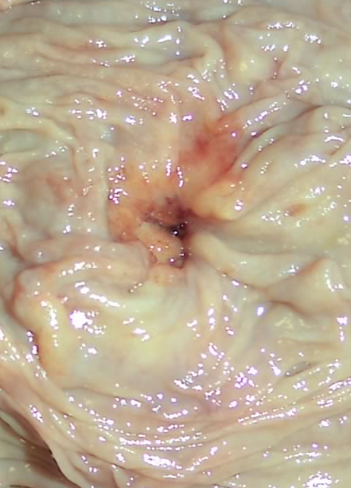
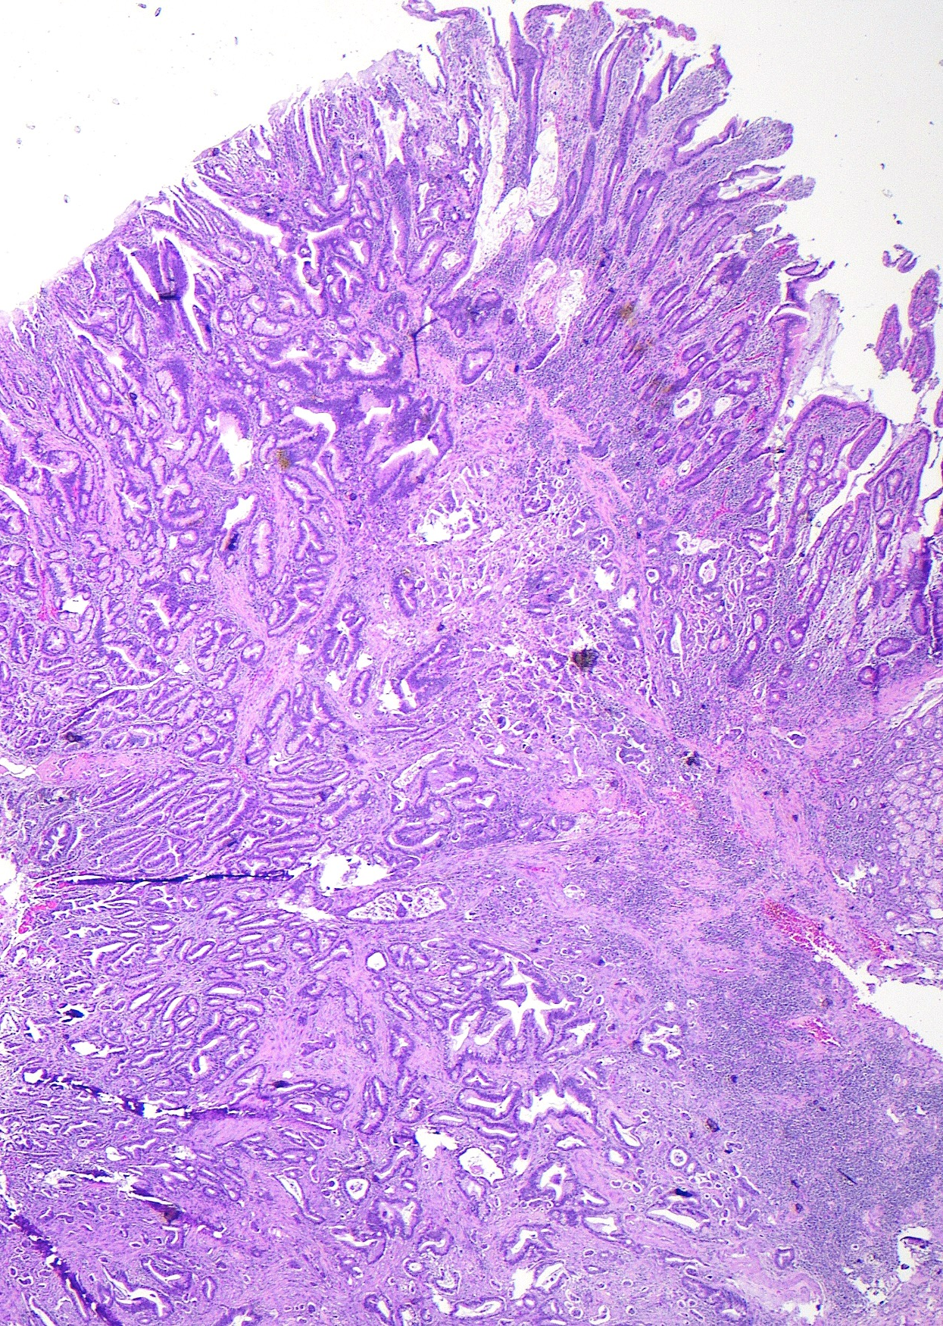
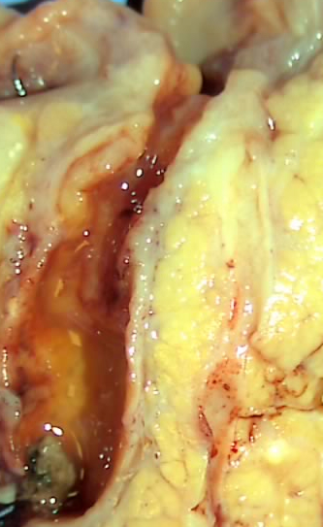

Slide 33
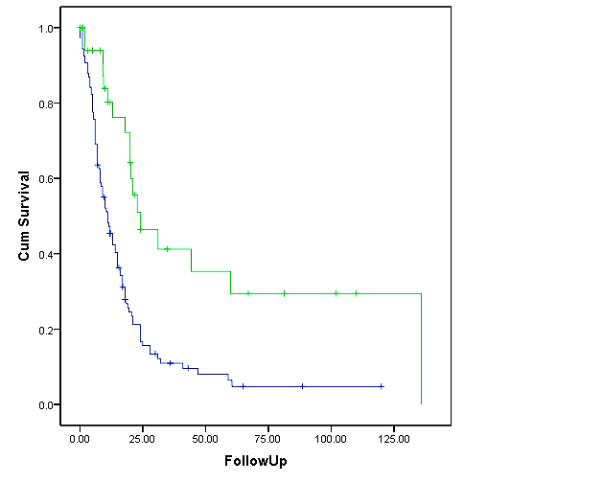
Nevertheless, still much better than PDAC
Log rank p-value <0.0001
CUM. SURVIVAL
AMP-ductal
Panc-ductal
FOLLOW UP

Slide 34
OUR DIAGNOSIS OF THE CASE
Ampulla, pancreas, CBD; pancreatoduodenectomy:
Invasive adenocarcinoma (1.7 cm) of ampullary-duct origin, pancreatobiliary type
POV
PD
CBD

Slide 35
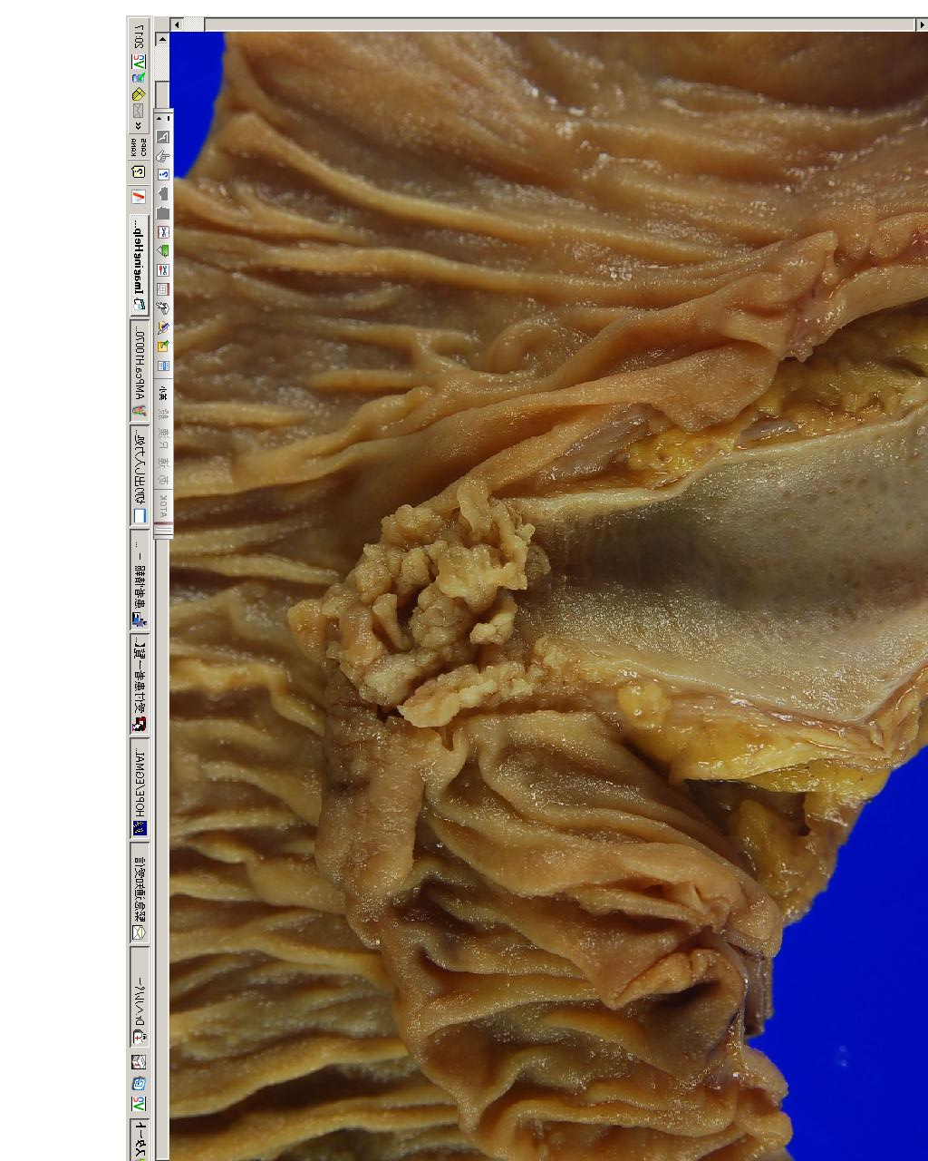
“INTRA-AMPULLARY” TUMORS COMPRISE 2 VERY DISTINCT CATEGORIES
IAPN-associated (adenomatous lesions)
Ampullary-ductal (schirrous) carcinoma

Slide 36
“INTRA-AMPULLARY” TUMORS COMPRISE 2 VERY DISTINCT CATEGORIES
~ IPMN of Ampulla
~ “PDAC” of Ampulla
IAPN-associated (adenomatous lesions)
Ampullary-ductal
(schirrous) carcinoma

Slide 37
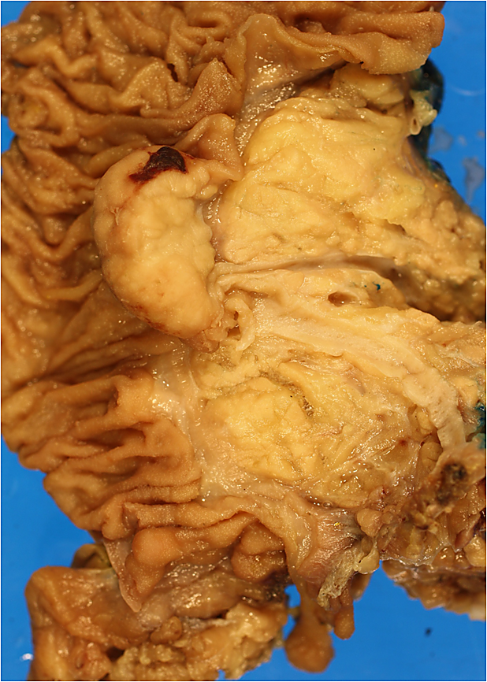
Case
22, M
Diagnosed with a “ampullary cancer”
Underwent pancreatoduodenectomy
PD
C B D

Slide 38

Which category does this belong to?
Intraampullary
(Peri)ampullary duodenal
Papilla of Vater
Ampullary-ductal
Other
PD
C B D

Slide 39
Which category does this belong to?
Intraampullary
Ampullary-ductal
(Peri)ampullary duodenal
Mixed
Other
PD
C B D

Slide 40
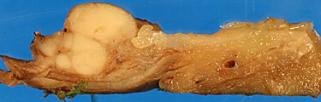
Duodenal surface
POV
CBD

Slide 41
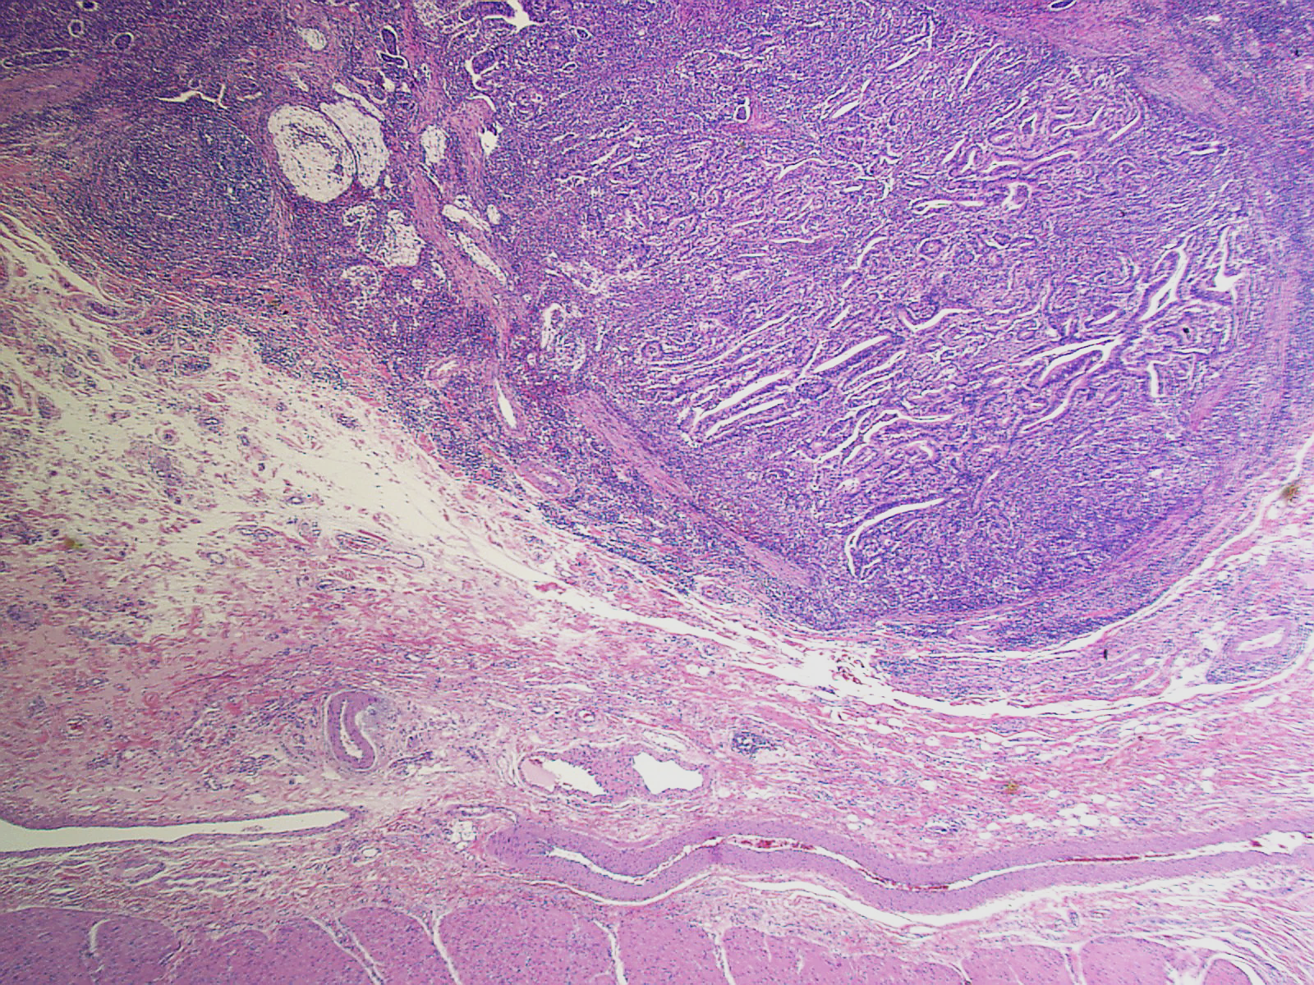
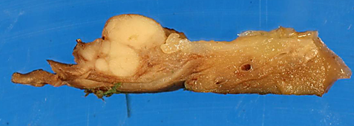
Well-demarcated nodules (“pushing-border” type infiltration)

Slide 42
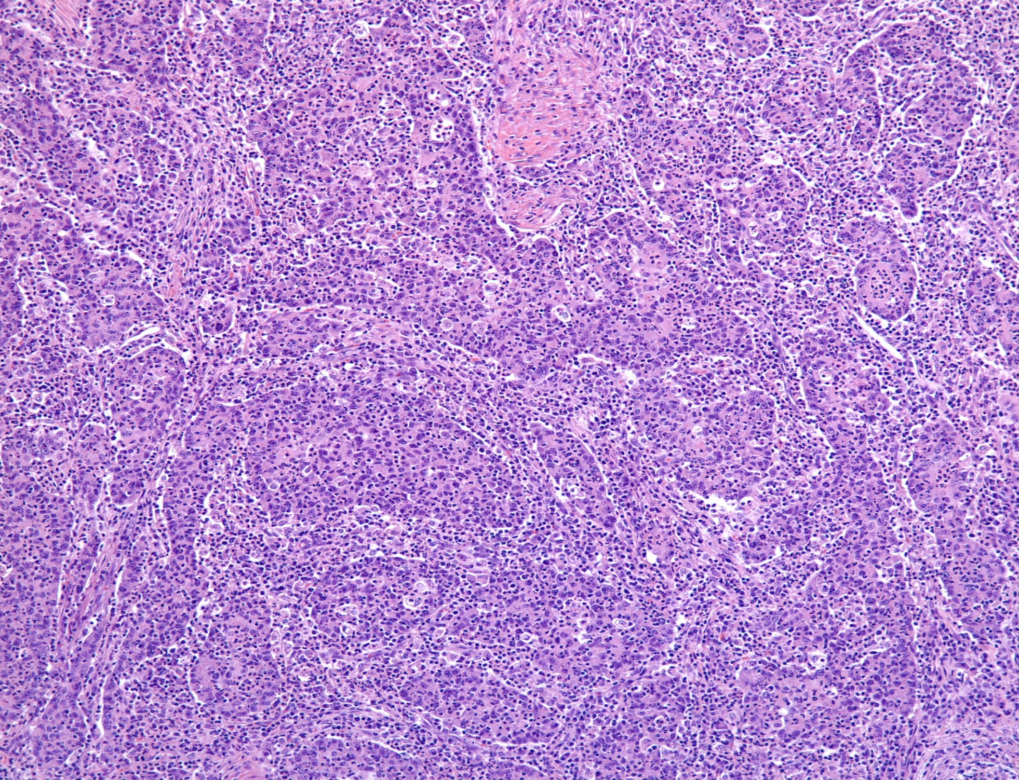
Syncitial growth pattern and lymphoplasmacytic/neutrophilic infiltrates

Slide 43
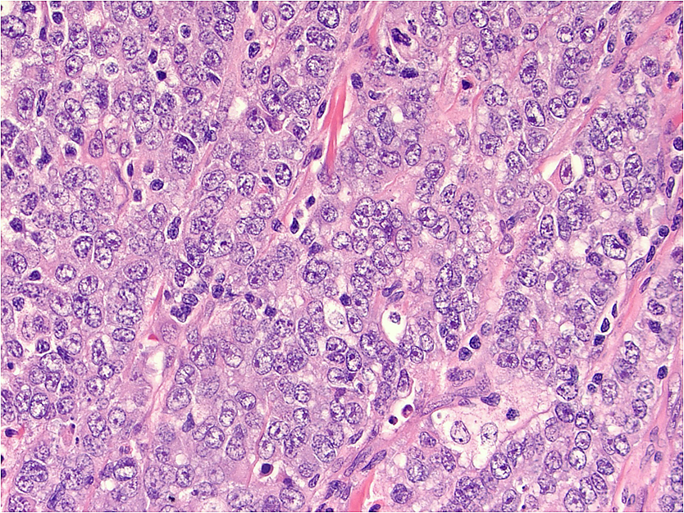

Slide 44
Lymphoma
Pancreatobiliary-type adenocarcinoma
Intestinal type adenocarcinoma
Poorly cohesive cell carcinoma (w/wo signet ring cells)
Medullary carcinoma

Slide 45
Lymphoma
Pancreatobiliary-type adenocarcinoma
Intestinal type adenocarcinoma
Poorly cohesive cell carcinoma (w/wo signet ring cells)
MEDULLARY CARCINOMA

Slide 46
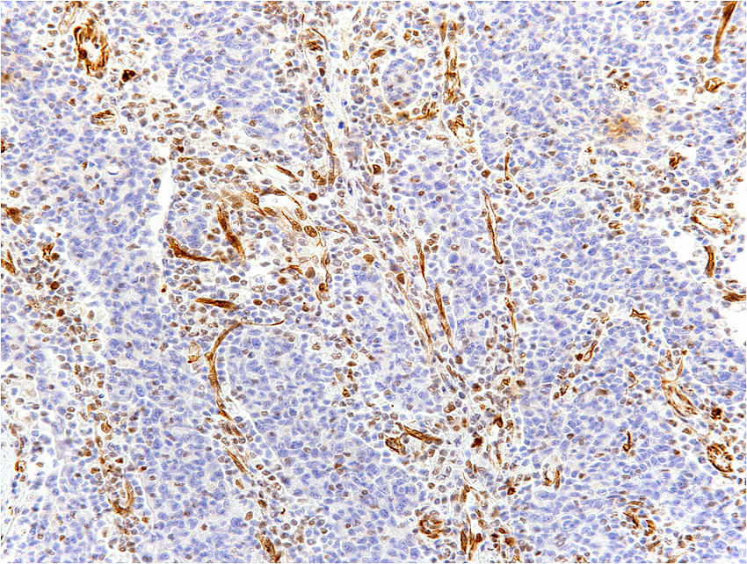
Loss of MLH1 staining in the tumor cells confirms
microsatellite instability
MLH 1

Slide 47
Case - Diagnosis
Medullary carcinoma of
ampullary-duodenum
Note: Subsequent genetic analysis revealed HNPCC (implications for both the patient and family)

Slide 48
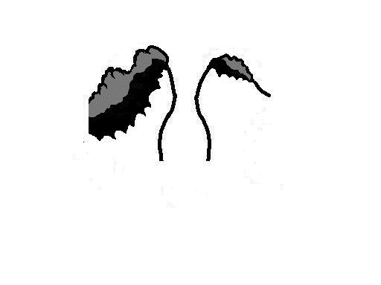
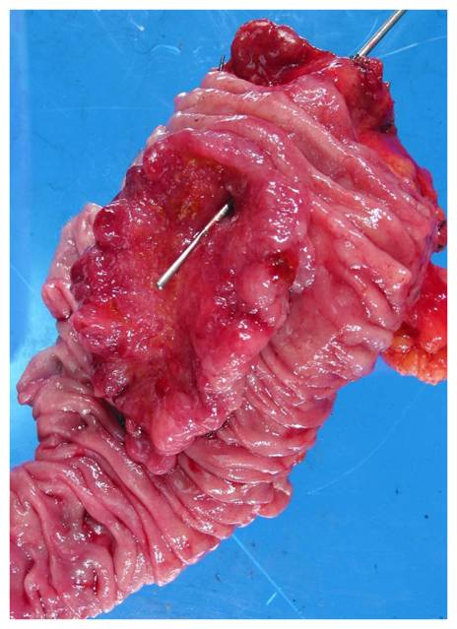
(PERI)AMPULLARY-DUODENAL
Ulcero-vegetating tumors within the duodenal lumen
Ampullary orifice is eccentrically localized
(superior edge)
Large (mean, ~ 5 cm;
mean i-size, 3.5)
Notes:
These were tumors that had substantial exophytic, vegetating component on the duodenal surface of ampulla, often the vegetating component, which translates to preinvasive neoplasm grew distally (presumably due to gravity) and left the ampullary orifice as an eccentric hole within the lesion.

Slide 49
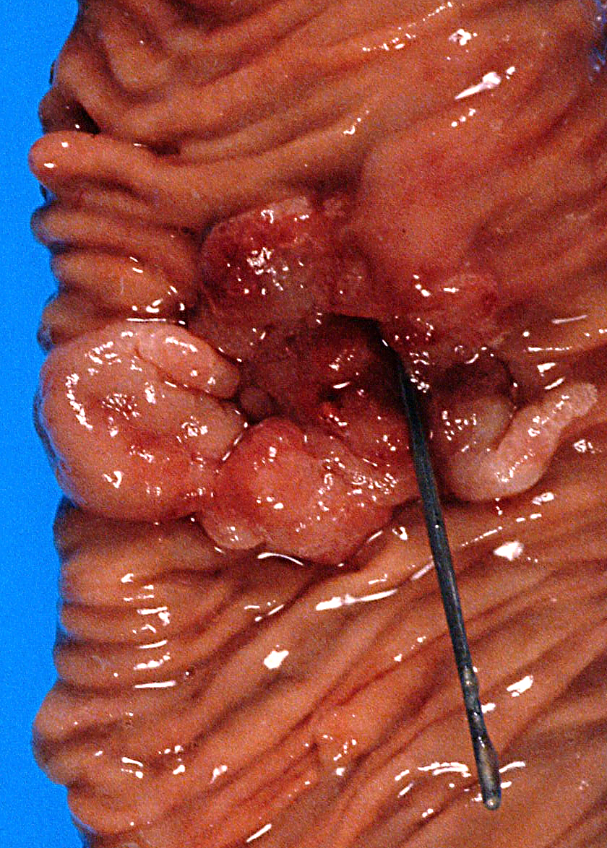
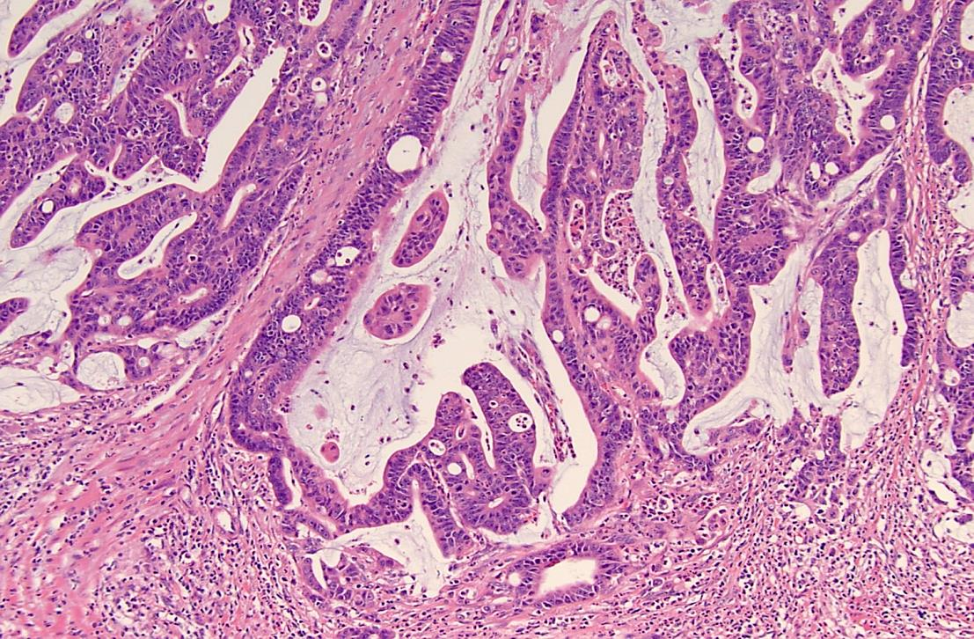
(Peri)ampullary-duodenal
Most, with adenoma component
Most (> 75%) INT-type, or mixed mucinous-intestinal
Frequent LN mets, but protracted clinical course (3-yr, 63%)

Slide 50

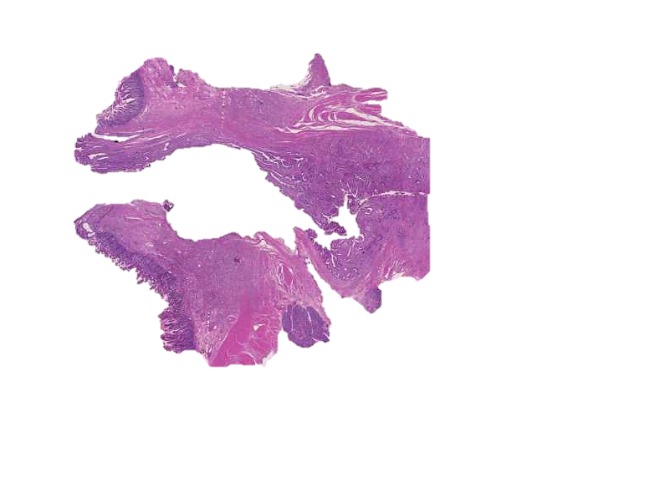
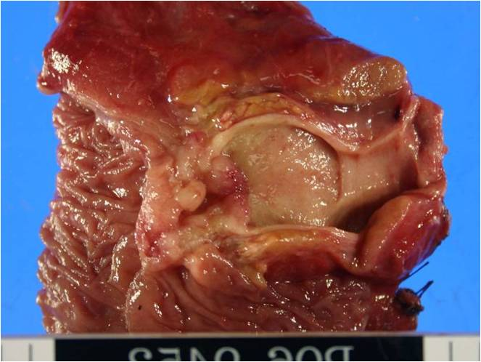
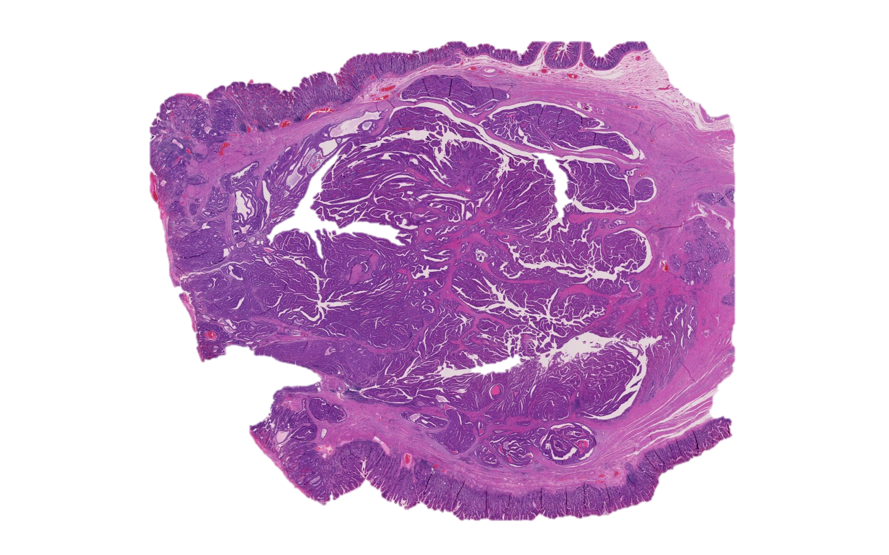

Amp-ductal is the most aggressive (38 mths) despite small size (1.7 cm) and frequent LN mets (57%).
CBD
PD
POV
IAPN (intra-ampullary papillary tubular neoplasm)-associated, has the best survival (133 mths) and lowest rate of LN mets (28%).
CBD
POV
Amp-duodenal is indolent (median, 103 mths) despite large size (3.2 cm) and frequent LN mets (64%).

Slide 51
Case - History
66, M
Presented with abdominal pain and weight loss
CT scan: Mass in the head of the pancreas
Endoscopy: Mild bulging of the ampulla; biopsy was performed

Slide 52
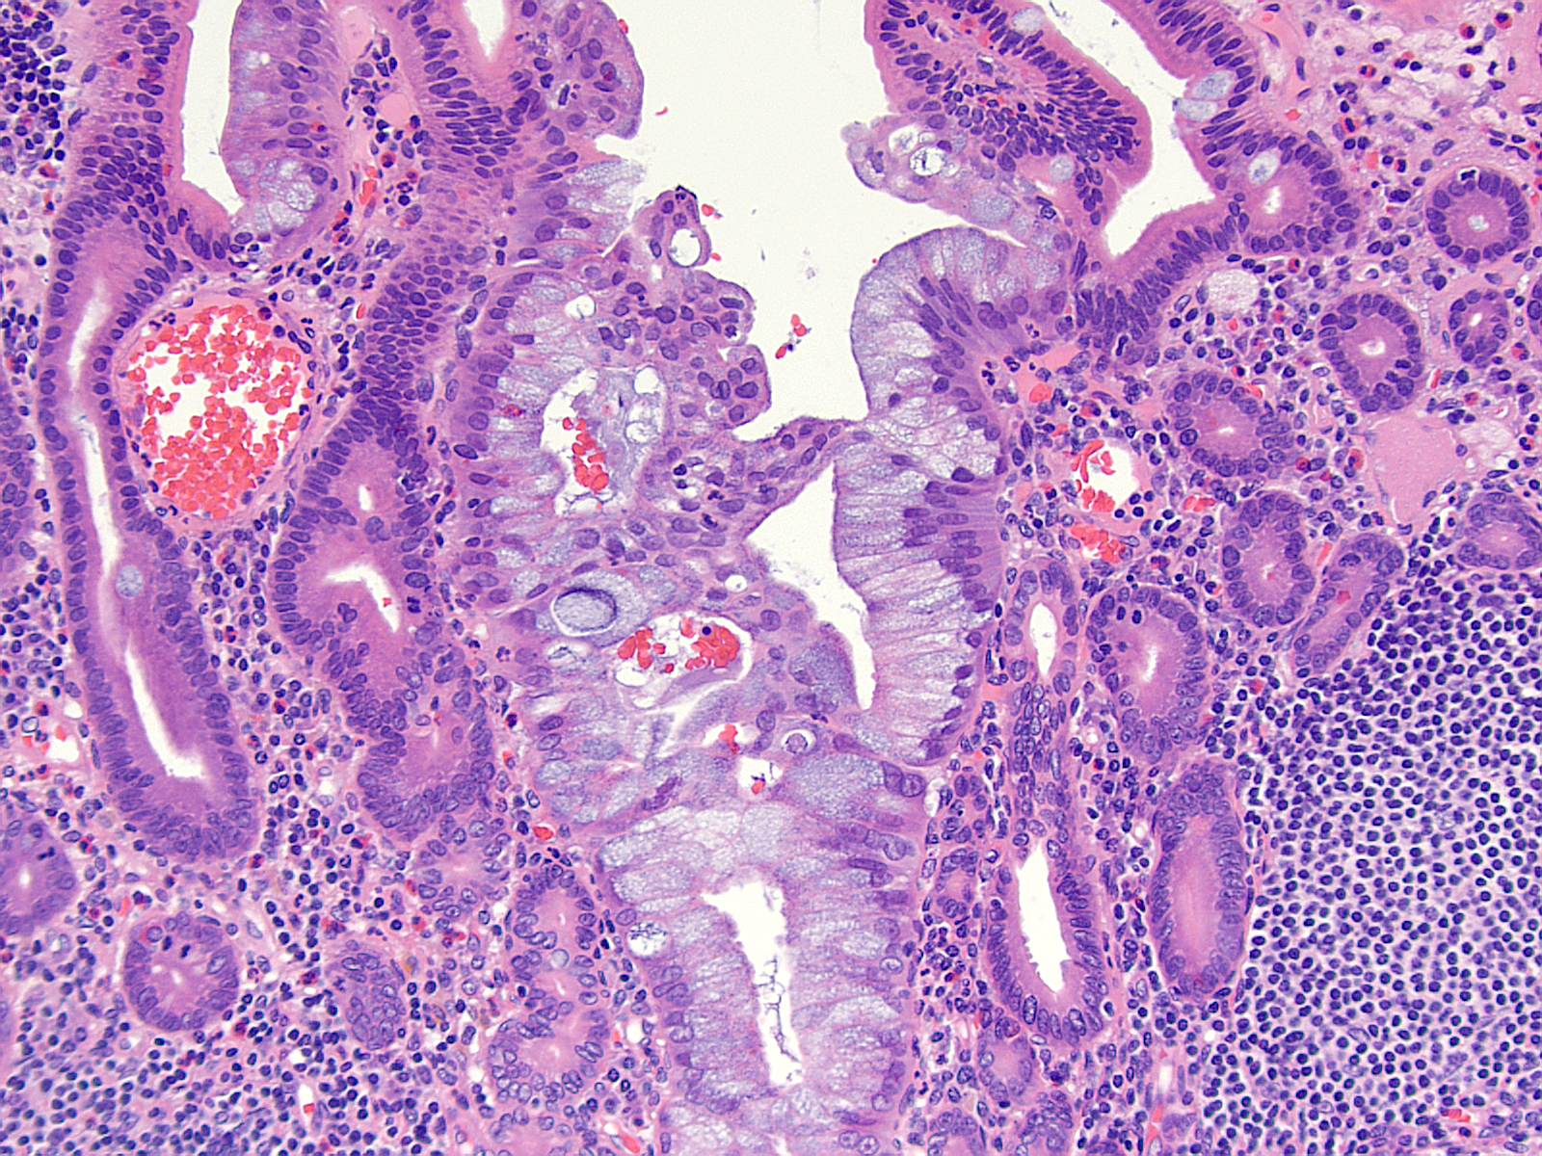

Slide 53
Metaplasia
Reactive atypia
Atypia of undetermined significance
Dysplasia/ adenoma
Adenocarcinoma, probably pancreatobiliary-type, colonizing the mucosa

Slide 54
Metaplasia
Reactive atypia
Atypia of undetermined significance
Dysplasia/ adenoma
Adenocarcinoma, probably pancreatobiliary-type, colonizing the mucosa

Slide 55
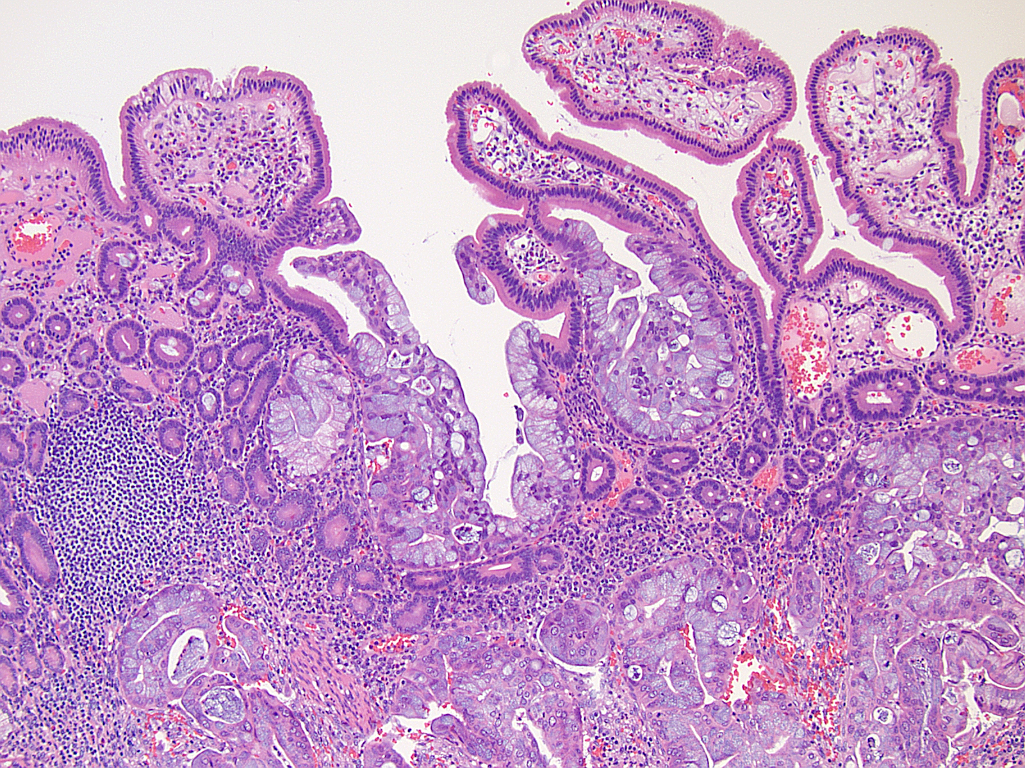
In resection specimen: Pancreatobiliary type invasive carcinoma colonizing the ampullary mucosa

Slide 56



Slide 57
Histologic classification of Ampullary carcinomas

Slide 58
Intestinal-type mucosa
Ducts
Hybrid epithelia
Notes:
This complexity is also reflected at the histologic level with intestinal type mucosa transforms into a hybrid mucosa of the Papilla of Vater showing goblet cells in foveolar-like epithelium, and admixed with ductules of the type that are seen in pancreatobiliary tract

Slide 59

Ampullary structures often have hybrid characteristics
Example: CDX2 expression in pancreatobiliary-type ductules of the ampulla

Slide 60




Various Histologic Subtypes
Intestinal
Pancreatobiliary (ductal)
Mixed mucinous-intestinal
Poorly differentiated/diffuse-infiltrative
Notes:
Therefore it is not surprisng that this are can give rise to a variety of histologic types of carcinoma including those with intestinal differentiation and those that are more pancreatobiliary or poorly dif NOS or even signet ring types
that the carcinomas arising in this region are highly versatile, creating different histologic types and often hybrid forms

Slide 61


Typing of Ampullary Carcinomas (AC) as pancreatobiliary (PB) vs intestinal (IN) histologically and by IHC is now an integral part of the management protocols
Pancreatobiliary
Intestinal

Slide 62
However,…

Slide 63

Prognostic correlation of the Histo-typing is present but not as strong as it is believed
p=0.04
IN: intestinal
PB: pancreatobiliary
IN
Survival rate
PB
Months

Slide 64

Composite patterns can be seen in different areas of the same case
PB
INT
Notes:
Second, in a few cases, there was a composite pattern, not only in the advancing edge but also within the main part of the tumor.

Slide 65

Histologic typing: > 40% AC are of MIXED type

Slide 66

Histologic typing: > 40% AC are of MIXED type
Intestinal
Pancreatobiliary
Mixed intestinal and pancreatobiliary type
Reid et al, Mod Pathol, 2016 Dec;29(12):1575-1585

Slide 67



How do we report this case ?

Slide 68


Can immunohistochemistry help?
MSKCC study
Australian-Verona study

Slide 69

Our experience: IHC does not seem to be as helpful as previously thought
AJSP, July , 2017
We tested the proposed Chang and Ang panels in 136 cases and found out that:
May be, selectively.
More work is needed.

Slide 70
Testing of the Ang/MSKCC Panel (our experience*)
cut off >25%
Ang’s study
This study
Ang’s criteria:
Ang- IN
CK20 + or CDX2+ or MUC2+ and MUC1-
CK20+ and CDX2+ and MUC2+, (MUC1+/-)
43 %
35 %
Ang- PB
MUC1+ and CDX2- and MUC2-, (CK20+/-)
39 %
36 %
Ang- AMB (ambiguous)
18 %
29 %
*

Slide 71


None of these markers show any prognostic value with different thresholds.
MUC1
MUC2
CDX2
p=0.98
p=0.18
p=0.57
Survival rate
Survival rate
Survival rate
>20%
≤ 25%
≤ 20%
≤ 20%
>20%
>25%
Months
Months
Months
Notes:
Need to be changed

Slide 72

Ang Panel – Histology correlation (in Emory cases)
High specifcity
Very few cross-overs btw PB and IN:
None of the H-IN were classified as Ang PB, and only 4 H-PB as Ang IN.
Moderate sensitivity
61% of H-PB cases were Ang PB;
77% of H-IN cases were Ang IN;
But unfortunately, several classic IN and PB cases fell into the Ang Ambiguous category.
Ang-Ambiguous

Slide 73
Example diagnosis for a mixed/hybrid case
Ampulla, pancreas, CBD;
pancreatoduodenectomy:
Invasive adenocarcinoma (2.8cm) of ampullary-duodenal origin, tubular type with mixed phenotype (predominantly intestinal with mixed pancreatobiliary features; see comment).
[Synoptic]
Note:
Immunohistochemically, this invasive carcinoma shows {---}, and therefore, according to the Ang panel, this case would qualify as “{—}” type (AJSP, 2014).

Slide 74




New kid on the block (with great promise): MUC5AC
All comers
Tubular only
p=0.0002
p=0.0004
≤ 20%
≤ 20%
>20%
>20%
Survival rate
Survival rate
p=0.02
p=0.03
0%
0%
≥ 1%
≥ 1%
Months
Months

Slide 75
MUC5AC stratified significantly the Histo-PB and Histo-IN cases
H-PB
H-IN
p=0.01
p=0.03
MUC5AC≤ 20%
Survival rate
Survival rate
MUC5AC≤ 20%
MUC5AC>20%
MUC5AC>20%
Months
Months
 | H-PB | H-IN | SENS | SPEC | PPV | NPV
MUC5AC | 65% | 35% | 0.60 | 0.68 | 0.65 | 0.63

Slide 76
Example diagnosis
Ampulla, pancreas, CBD;
pancreatoduodenectomy:
Invasive adenocarcinoma (2.8cm) of ampullary-duodenal origin, tubular type with mixed phenotype (predominantly intestinal with mixed pancreatobiliary features; see comment).
[Synoptic]
Note:
Immunohistochemically, this invasive carcinoma shows {---}, and therefore, according to the Ang panel, this case would qualify as “{—}” type (AJSP, 2014).
{MUC5AC, which appears to be associated with adverse prognosis, is negative}.

Slide 77


CONCLUSION: Ampulla continues to be problematic
As a region ….
that is relatively rarely encountered
anatomically complex (composed of 4 distinct units)
showing many transitional structures
and leading to highly versatile pathology
…ampulla and its neoplasms continue to be poorly characterized
Notes:
VERSITIL

Slide 78


